Slide 1
Multi-armed Bandit Problems
WAIM 2014
Jian Li
Institute for Interdisciplinary Information Sciences
Tsinghua University

Slide 2
Decision making with limited information
An “algorithm” that we use everyday
Initially, nothing/little is known
Explore (to gain a better understanding)
Exploit (make your decision)
Balance between exploration and exploitation
We would like to explore widely so that we do not miss really good choices
We do not want to waste too much resource exploring bad choices (or try to identify good choices as quickly as possible)

Slide 3
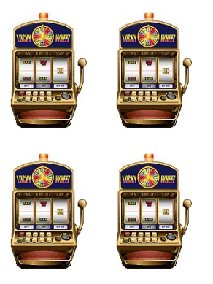
The Stochastic Multi-armed Bandit
Stochastic Multi-armed Bandit
Set of $n$ arms
Each arm is associated with an unknown reward distribution supported on [0,1] with mean $θ_{i}$
Each time, sample an arm and receive the
reward independently drawn from the
reward distribution
classic problems in stochastic control, stochastic optimization and online learning

Slide 4
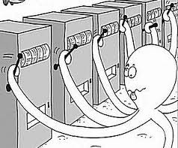
The Stochastic Multi-armed Bandit
Stochastic Multi-armed Bandit (MAB)
MAB usually refers to a class of problems (many variations)
Problem 1 (Top-K Arm identification problem)
You can take N samples
-A sample: Choose an arm, play it once, and observe the reward
(Approximately) Identify the best K arms (arms with largest means)
Goal: Minimize N.

Slide 5
Motivating Applications
Wide Applications:
Clinical Trials (Thompson, 1933). Sequential experimental design, Evolutionary Computing, Online learning, Stochastic network optimization.
Motivating Application: Crowdsourcing
Crowd

Slide 6
Motivating Applications
Workers are noisy
How to identify reliable workers and exclude unreliable workers ?
Test workers by gold tasks (i.e., tasks with known answers)
Each test costs money. How to identify the best $K$workers with minimum amount of money?
0.95
0.99
0.5
Top-$K$ Arm Identification
Worker | Bernoulli arm with mean $θ_{i}$ ($θ_{i}: i$-th worker’s reliability)
Test with golden task | Obtain a binary-valued sample (correct/wrong)

Slide 7
Evaluation Metric
Sorted means $θ_{1}≥θ_{2}≥…≥θ_{n}$
Goal: find a set of $K$ arms $T$to minimize the regret
Given any $ε,δ,$ the algorithm outputs a set $T$of $K$arms such that $L_{T}≤ε$, with probability at least $1−δ$ (PAC learning)
For $K=1,$ i.e., find $\hat{i}:$ $θ_{1}−θ_{\hat{i}}≤ε$ w.p. $1−δ$
[Evan-Dar, Mannor and Mansour, COLT2006]
[Mannor, Tsitsiklis, JLMR2004]
This Talk: For general K [Zhou, Chen, L. ICML14]
$$L_{T}=\frac{1}{K}\left(\sum_{i=1}^{K}{θ_{i}}−\sum_{i∈T}{θ_{i}}\right)$$

Slide 8
Simplification
Assume Bernoulli distributions from now on
Think of a collection of biased coins
Try to (approximately) find K coins with largest bias
(towards head)
0.9
0.5
0.6
0.33
…….

Slide 9
Why regret?
Misidentification Probability (Bubeck et. al., ICML13):
Consider the case: (K=1)
$$\operatorname{Pr}{(T≠\{1,2,…,K\})}$$
1
0.9999
Distinguish such two coins with high confidence requires approx 10^4 samples
(#samples depends on the gap $θ_{1}−θ_{2}$)
Using regret (say with $ε=0.01)$, we may choose either of them

Slide 10
Naïve Solution
Uniform Sampling
Sample each coin M times
Pick the K coins with the largest empirical means
empirical mean: #heads/M
How large M needs to be (in order to achieve $ε$-regret)??
So the total number of samples is O(nlogn)
$$M=O(\frac{1}{ε^{2}}\left(log\frac{n}{K}+\frac{1}{K}\log{\frac{1}{δ}}\right))=O(\log{n})$$

Slide 11
Naïve Solution
Uniform Sampling
With M=O(logn), we can get an estimate $θ_{i}^{′}$ for $θ_{i}$ such that $\left|θ_{i}−θ_{i}^{′}\right|≤ε$ with very high probability (say $1−\frac{1}{n^{2}}$)
This can be proved easily using Chernoff Bound (Concentration bound).
What if we use M=O(1) (let us say M=10)
E.g., consider the following example (K=1):
0.9, 0.5, 0.5, …………………., 0.5 (a million coins with mean 0.5)
Consider a coin with mean 0.5,
Pr[All samples from this coin are head]=(1/2)^10
With const prob, there are more than 500 coins whose samples are all heads

Slide 12
Uniform Sampling
In fact, we can show a matching lower bound
$$M=Θ(\frac{1}{ε^{2}}\left(log\frac{n}{K}+\frac{1}{K}\log{\frac{1}{δ}}\right))=Θ(\log{n})$$
One observation: if $K=Θ\left(n\right), M=O(1)$.

Slide 13
Can we do better??
Consider the following example:
0.9, 0.5, 0.5, …………………., 0.5 (a million coins with mean 0.5)
Uniform sampling spends too many samples on bad coins.
Should spend more samples on good coins
However, we do not know which one is good and which is bad……
Sample each coin M=O(1) times.
If the empirical mean of a coin is large, we DO NOT know whether it is good or bad
But if the empirical mean of a coin is very small, we DO know it is bad (with high probability)

Slide 14
Optimal Multiple Arm Identification (OptMAI)
Input: $n$(no. of arms), $K$(top-$K$ arms), $Q$(total no. of samples/budget)
Initialization: Active set of arms $S_{0}=\left\{1,2,…, n\right\},$Set of top arms $T_{0}=∅$
Iteration Index $r=0,$ Parameter $β∈\left(0.75, 1\right)$
While $\left|T_{r}\right|<K$ and $\left|S_{r}\right|>0 do$
If $\left|S_{r}\right|>4K$then
$S_{r+1}$=Quartile-Elimination$(S_{r}, β^{r}\left(1−β\right)Q)$
Else ($\left|S_{r}\right|≤4K)$
Identify the best K arms for at most 4K arms,
using uniform sampling
$r=r+1$
Output: set of selected $K$ arms $T_{r}$
Eliminate one quarter arms with lowest empirical means

Slide 15
Quartile-Elimination
Idea: uniformly sample each arm in the active set $S$ and discard the worst quarter of arms (with the lowest empirical mean)
Input: $S$(active arms), $Q$(budget)
Sample each arm $i∈S$ for $Q/\left|S\right|$ times & let ${\hat{θ}}_{i}$ be the empirical mean
Find the lower quartile of the empirical mean $\hat{q}$: $|\{i:$ ${\hat{θ}}_{i}<\hat{q}\}|=|S|/4$
Output: $S^{′}=S \backslash$ $\{i:$ ${\hat{θ}}_{i}<\hat{q}\}$

Slide 16
Sample Complexity
Sample complexity $Q$:
Outputs $K$arms s.t. $L_{T}=\frac{1}{K}\left(\sum_{i=1}^{K}{θ_{i}}−\sum_{i∈T}{θ_{i}}\right)≤ε$, w.p. $1−δ$.
$K≤\frac{n}{2}: Q=O\left(\frac{n}{ε^{2}}\left(1+\frac{\ln\left(\frac{1}{δ}\right)}{K}\right)\right)$ (this is linear!)
$K≥\frac{n}{2}:Q=O\left(\frac{n−K}{K}\frac{n}{ε^{2}}\left(\frac{n−K}{K}+\frac{\ln\left(\frac{1}{δ}\right)}{K}\right)\right)$ (which can be sublinear!)
Apply our algorithm to identify the worst $\left(n−K\right)$arms.

Slide 17
Sample Complexity
$K≤\frac{n}{2}: Q=O\left(\frac{n}{ε^{2}}\left(1+\frac{\ln\left(\frac{1}{δ}\right)}{K}\right)\right)$
$K=1, Q=O\left(\frac{n}{ε^{2}}\ln\left(\frac{1}{δ}\right)\right)$ [Even-Dar et. al., 06]
For larger $K,$ the sample complexity is smaller: identify $K$ arms is simpler !
Why? Example: $θ_{1}=\frac{1}{2}+2ε, θ_{2}=θ_{3}=…θ_{n}=\frac{1}{2}.$
Identify the first arm ($K=1$) is hard ! Cannot pick the wrong arm.
Since $L_{T}≤\frac{2ε}{K},$ for $K≥2 ,$any set is fine.
Naïve Uniform Sampling: $Q=Ω\left(nlog\left(n\right)\right),$log$\left(n\right)$ factor worse

Slide 18
Matching Lower Bounds
$K≤\frac{n}{2}:$ there is an underlying $\left\{θ_{i}\right\}$ such that for any randomized algorithm, to identify a set $T$with $L_{T}≤ε$ w.p. at least $1−δ,$
$$E[Q]=Ω\left(\frac{n}{ε^{2}}\left(1+\frac{\ln\left(\frac{1}{δ}\right)}{K}\right)\right)$$
$K>\frac{n}{2}:E[Q]=Ω\left(\frac{n−K}{K}\frac{n}{ε^{2}}\left(\frac{n−K}{K}+\frac{\ln\left(\frac{1}{δ}\right)}{K}\right)\right)$
Our algorithm is optimal for every value of $n,K, ε, δ!$

Slide 19
Matching Lower Bounds
First Lower bound: $K≤\frac{n}{2}, Q≥Ω\left(\frac{n}{ε^{2}}\right)$
Reduction to distinguishing two Bernoulli arms with means $\frac{1}{2}$ and $\frac{1}{2}+ε$with probability $>0.51,$ which requires at least $Ω\left(\frac{1}{ε^{2 }}\right)$ samples [Chernoff, 72]
(anti-concentration)
Second Lower bound: $K≤\frac{n}{2}, Q≥Ω\left(\frac{n}{ε^{2}}\left(\frac{\ln\left(\frac{1}{δ}\right)}{K}\right)\right)$
A standard technique in statistical decision theory

Slide 20
Experiments
OptMAI | $β=0.8, β=0.9$
SAR | Bubeck et. al., 13
LUCB | Kalyanakrishnan et. al., 12
Uniform | Naïve Uniform Sampling
Simulated Experiments:
No. of Arms: $n=1000$
Total Budget: $Q=20n, Q=50n, Q=100n$
Top-$K$ Arms: $K=10, 20, …, 500$
Report average result over 100 independent runs
Underlying distributions:
$θ_{i}\sim Uniform\left[0,1\right]$
$θ_{i}=0.6$ for $i=1,…,K$, $θ_{i}=0.5$ for $i=K+1, …, n$
Metric: regret $L_{T}$

Slide 21
Simulated Experiment
$θ_{i}\sim Uniform\left[0,1\right]$

Slide 22
Simulated Data
$θ_{i}=0.6 \text{for} i=1,…,K\text{, }θ_{i}=0.5 \text{for} i=K+1, …, n$

Slide 23
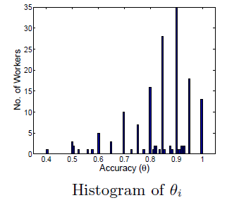
Real Data
RTE data for textual entailment
(Snow et. al., 08)
800 binary labeling tasks with true labels
164 workers

Slide 24
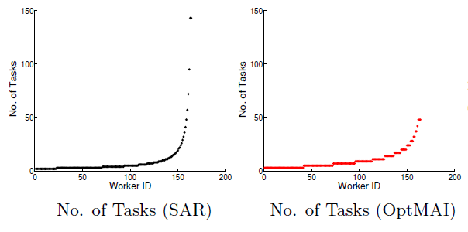
Real Data
Empirical distribution of the number tasks assigned to a worker
($β=0.9, K=10, Q=20n)$
Crowdsourcing:
Impossible to assign too many tasks to a single worker
A worker receives at most 143 tasks
SAR queries an arm
$Ω\left(\frac{Q}{log\left(n\right)}\right)$ times
A worker receives at most 48 tasks
OptMAI queries an arm $O\left(\frac{Q}{n^{Ω\left(1\right)}}\right)$ times

Slide 25
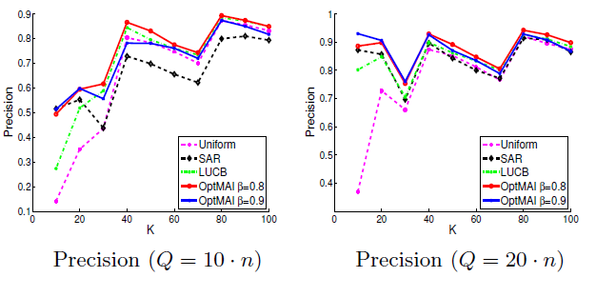
Real Data
Precision = $\frac{|T∩\left\{1,…,K\right\}| }{K}:$ no. of arms in $T$belongs to the top $K$arms

Slide 26
Multi-armed Bandit
In some sequential decision problems, there is no clear separation between exploration and exploitation.
So we have to Explore-While-Exploit
Problem 2:
Play for T rounds
$X_{t}$: the reward received at round t
Minimize the expected regret
$$L_{T}=\left(θ_{1}−\frac{1}{T}\sum_{t=1…T}{X_{t}}\right)$$
Each time play 1 arm
$$L_{T}=\left(\sum_{i=1…K}{θ_{i}}−\frac{1}{T}\sum_{t=1…T}{X_{t}}\right)$$
Each time play K arms

Slide 27
Multi-armed Bandit
There are many variations of MAB
Stochastic, Adversial, Markovian
Side information
Contextual bandit
Several meaningful objective functions
Regret, expected regret, pseudo-regret
See the comprehensive survey by Bubeck and Cesa-Bianchi

Slide 28
Multi-armed Bandit
An application in ranking documents
A set of documents D={d₁,…,d_{n}}.
A population of users.
Users of type i will click d_{j} with prob p_{ij}
Each time the system presents to the user a top-k list.
The user click the first doc she likes.
Objective: Maximizes E[#users who click at least once]
unknown
Play k arms
rewards
Top-k
click
Top-k
click
Learning diverse ranking with multi-armed bandits. Radlinski, Kleinberg and Joachims. ICML08.

Slide 29
Final Remarks
MAB is a very powerful framework to describe sequential decision problems with limited information.
Has found many applications in several areas.
I am not aware of much work in DB community, except an application in data cleaning [Cheng at al. VLDB10]
Might be useful/helpful in your own research problems!

Slide 30
Thanks. lapordge@gmail.com

