Slide 1

Algorithms for Stochastic Geometric and Combinatorial Optimization Problems
CAS 2015
Jian Li
Institute of Interdisciplinary Information Sciences
Tsinghua University
lijian83@mail.tsinghua.edu.cn
TexPoint fonts used in EMF.
Read the TexPoint manual before you delete this box.: AAAAAAAAAAAAAA

Slide 2
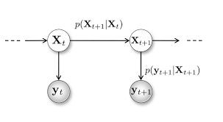
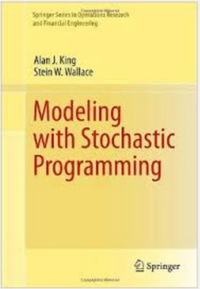
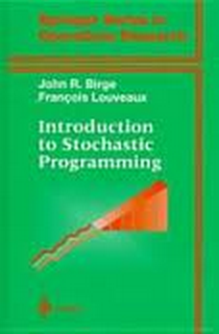
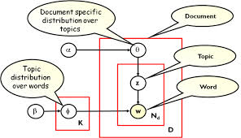
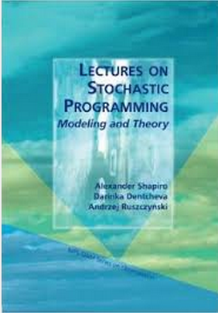
Uncertain Data and Stochastic Model
  Data Integration and Information Extraction
  Sensor Networks; Information Networks
  Probabilistic models in machine learning
Sensor ID | Temp.
1 | Gauss(40,4)
2 | Gauss(50,2)
3 | Gauss(20,9)
… | …
Probabilistic databases
Probabilistic Models in machine learning
Stochastic models in operation research

Slide 3
Outline
Stochastic Models
Classical Examples: E[MST]
Estimating E[MST] and other statistics
Stochastic Combinatorial Optimization: The Poisson Approximation Technique
Expected Utility Maximization: The Fourier Decomposition Technique
Stochastic Matching: The Linear Programming Technique
Conclusion

Slide 4
Stochastic Geometry Models
The position of each point is random (non-i.i.d)
All pts are independent from each other
A popular model in wireless networks/spatial prob databases
0.3
0.1
0.5
0.7
1
0.4
0.2
0.5
0.3
0.5
0.2
0.3
Locational uncertainty model

Slide 5
Stochastic Geometry Models
The position of each point is random (non-i.i.d)
All pts are independent from each other
A popular model in wireless networks/spatial prob databases
0.3
0.1
0.5
0.5
0.7
1
0.4
0.7
1
0.2
0.5
0.5
0.3
0.5
0.3
0.2
0.3
Locational uncertainty model
A realization (aka a possible world)
Prob=0.7*1*0.5*0.5*0.3

Slide 6
Stochastic Geometry Models
The position of each point is random (non-i.i.d)
All pts are independent from each other
A popular model in wireless networks/spatial prob databases
0.3
0.1
0.5
0.3
0.7
1
0.4
1
0.4
0.2
0.5
0.3
0.5
0.3
0.5
0.2
0.3
Locational uncertainty model
Another realization
Prob=0.3*1*0.4*0.5*0.3

Slide 7

Stochastic Geometry Models
A computational problem: Computing E[MST]
$$E\left[MST\right]=\sum_{r:realizations}{MST\left(r\right)×Pr⁡[r]}$$
0.3
0.5
+
0.4
+
0.7
1
1
……
*(0.7*1*0.5*0.5*0.3)
*(0.3*1*0.4*0.5*0.3)
0.3
0.5
0.3
0.5
However, this does not give a polynomial time algorithm
The stochastic geometry model has been studied in several recent papers for many different problems.
[Kamousi, Chan, Suri ‘11] [Afshani, Agarwal, Arge, Larsen, Phillips. ‘11][Agarwal, Cheng, Yi. ‘12] [Abdullah, Daruki, Phillips ‘13] [Suri, Verbeek, Yıldız ‘13] [Li, Wang ‘14] [Agarwal, Har-Peled, Suri, Yıldız, Zhang 14] [Huang, Li ‘15] [Huang, Li, Phillips, Wang ‘15]

Slide 8








Stochastic Graph Models
The length of each edge is a random variable
s
t

Slide 9
Outline
Stochastic Models
Classical Examples: E[MST]
Estimating E[MST] and other statistics
Stochastic Combinatorial Optimization: The Poisson Approximation Technique
Expected Utility Maximization: The Fourier Decomposition Technique
Stochastic Matching: The Linear Programming Technique
Conclusion

Slide 10
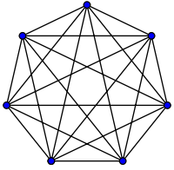
A classic problem in the stochastic graph model
A undirected graph with n nodes
The length of each edge: i.i.d. Uniform[0,1]
Question: What is E[MST]?
Ignoring uncertainty (“replace by the expected values” heuristic)
  each edge has a fixed length 0.5
  This gives the WRONG answer 0.5(n-1)

Slide 11
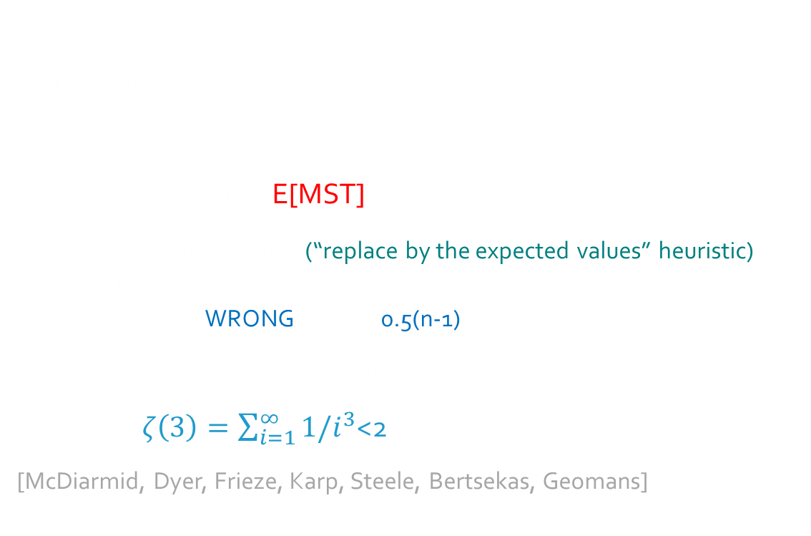
A classic problem in the stochastic graph model
A undirected graph with n nodes
The length of each edge: i.i.d. Uniform[0,1]
Question: What is E[MST]?
Ignoring uncertainty (“replace by the expected values” heuristic)
  each edge has a fixed length 0.5
  This gives a WRONG answer 0.5(n-1)
But the true answer is (as n goes to inf)
$ζ\left(3\right)=\sum_{i=1}^{∞}{1/i^{3}}$<2
[McDiarmid, Dyer, Frieze, Karp, Steele, Bertsekas, Geomans]

Slide 12
A classic problem in the stochastic geometry model
N points: i.i.d. uniform[0,1]×[0,1]
Question: What is E[MST] ?
Answer:

Slide 13

A classic problem in the stochastic geometry model
N points: the location of each point is i.i.d. uniform[0,1]×[0,1]
Question: What is E[MST] ?
Answer: $θ(\sqrt{n})$ [Frieze, Karp, Steele, …]
The problem is similar, but the answer is not similar…………

Slide 14
Outline
Stochastic Models
Classical Examples: E[MST]
Estimating E[MST] and other statistics
Stochastic Combinatorial Optimization: The Poisson Approximation Technique
Expected Utility Maximization: The Fourier Decomposition Technique
Stochastic Matching: The Linear Programming Technique
Conclusion

Slide 15
A Computational Problem
The position of each point is random (non-i.i.d)
Question: What is E[Closest pair] ?
Of Course, there is no close-form formula
We need efficient algorithms to compute E[Closest pair]
0.1
0.5
0.4
[Huang, L. ICALP15]

Slide 16
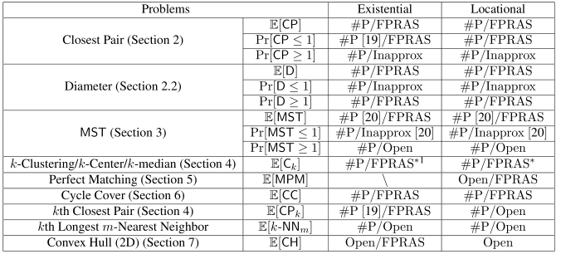
Our Results

Slide 17
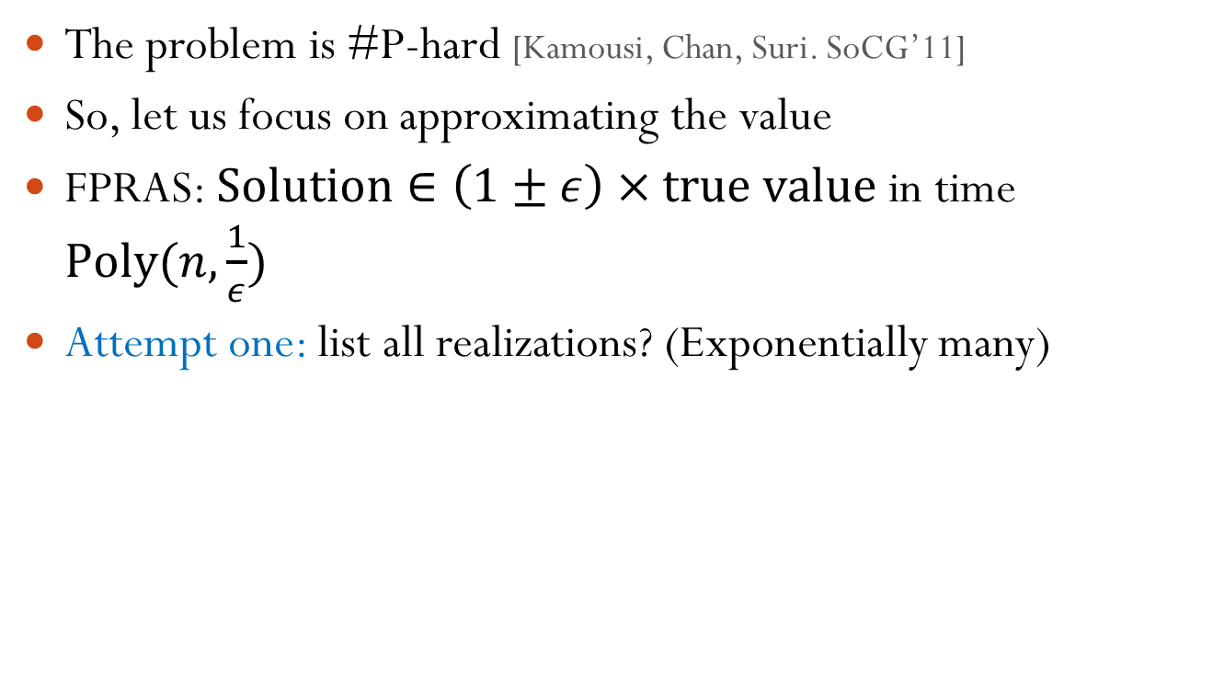
MST over Stochastic Points
The problem is #P-hard [Kamousi, Chan, Suri. SoCG’11]
So, let us focus on approximating the value
FPRAS: $Solution∈\left(1±ε\right)×true value$ in time $Poly(n,\frac{1}{ε})$
Attempt one: list all realizations? (Exponentially many)

Slide 18
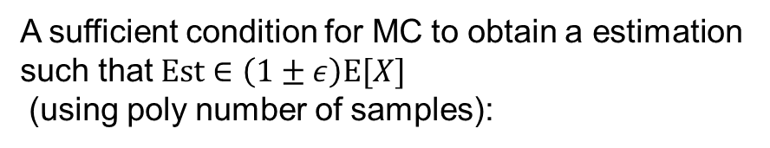


Monte Carlo
Attempt two: Naïve Monte Carlo (variance can be very large)
Suppose we want to estimate $E[X]$
MC: take N i.i.d. samples $X_{1},X_{2},…,X_{n}$
$$Our estimation=\frac{1}{N}\sum_{i=1…N}{X_{i}}$$
Consider the random var:
X=0, w.p. 0.999999999999999
X=1, w.p. 0.000000000000001
We need 1000000000000000 in expectation to get a sample of value “1”
A sufficient condition for MC to obtain a estimation such that $Est∈\left(1±ε\right)E[X]$
(using poly number of samples):
$$\frac{\max{X}}{E[X]}≤poly$$
We call X is a nice r.v.
(just Chernoff Bound)

Slide 19








Decompose the prob space
Our approach: (sketch)
Law of total expectation:
$$E\left[X\right]=\sum_{y}{\operatorname{Pr}\left[Y=y\right]E[X∣Y=y]}$$
How to choose Y?
A carefully chosen random event Y
Hopefully, we have
Easy to compute
Low variance
Or
$X∣Y=y$ is nice
$$y_{3}$$
$$y_{1}$$
$$y_{4}$$
$$y_{5}$$
$$y_{2}$$
$$y_{6}$$

Slide 20


#P-hardness
We only prove computing $\operatorname{Pr}{[Cp>1]}$ is #P-hard in general metric spaces
Pf: Reduction: counting #independent sets (#P-hard problem)
Len=1
Len=2
An independent set
Cp=2
$$\operatorname{Pr}{[Cp>1]}=Pr\left[Cp=2\right]=\#IS/2^{n}$$

Slide 21
Hierarchical Partition Family (HPF)
Level 0
5
Level 1
2
6
3
4
1
Level 2
A minimum spanning tree
Edges sorted by their lengths
...
Level 7

Slide 22
Use HPF to decompose the space
Events to condition on:
  Y: the smallest i such that each group in level i contains at most one realized point
Level 0
A realization
Level 1
Y=2 for this realization
Level 2

Slide 23
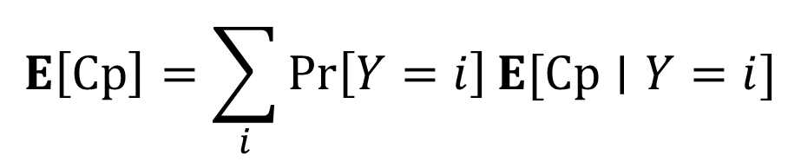

Use HPF to decompose the space
$$E\left[Cp\right]=\sum_{i}{\operatorname{Pr}\left[Y=i\right]E[Cp∣Y=i]}$$
We need two things:
We can compute $\operatorname{Pr}\left[Y=i\right]$ efficiently
$Cp∣Y=i$ is nice (and we can sample from)

Slide 24

Niceness
Show $Cp∣Y=i$ is nice
Y: the smallest i such that each group in level i contains at most one realized point
Key: $e_{i}≤Cp≤{ne}_{i}$
Level i-1
Level i
Only realized points are shown

Slide 25


Computing Pr[Y=i]
We can compute $\operatorname{Pr}\left[Y=i\right]$ efficiently
Can be reduced to the permanent approximation problem
FPRAS to approx Per(M) by Jerrum, Sinclair, and Vigoda

Slide 26
Computing Pr[Y=i]
Can be reduced to the permanent approximation problem
Consider a slightly simpler problem:
Compute Pr[each group gets at most 1 pt]=Per(M)
1 | 1 | 1
0.7 | 0.2 | 0.1
0.4 | 0.6 | 1
M=
0.4
0.2
0.6
0.1
1
0.7
A matching: each group gets at most 1 realized pt

Slide 27
Outline
Stochastic Models
Classical Examples: E[MST]
Estimating E[MST] and other statistics
Stochastic Combinatorial Optimization: The Poisson Approximation Technique
Expected Utility Maximization: The Fourier Decomposition Technique
Stochastic Matching: The Linear Programming Technique
Conclusion

Slide 28
Existing Techniques
A common challenge: How to deal with/ optimize on the distribution of the sum of several random variables.
  More often seen in the risk-aware setting (linearity of expectation does not help)
Previous techniques:
  Special distributions [Nikolova, Kelner, Brand, Mitzenmacher. ESA’06] [Goel, Indyk. FOCS’99] [Goyal, Ravi. ORL09] …..
  Effective bandwidth [Kleinberg, Rabani, Tardos STOC’97]
  LP [Dean, Goemans, Vondrak. FOCS’04] …..
  Discretization [Bhalgat, Goel, Khanna. SODA’11]
  Characteristic Function + Fourier Series Decomposition [L, Deshpande. FOCS’11]
Today: Poisson Approximation [L, Yuan STOC’13]

Slide 29
Threshold Probability Maximization
Deterministic version:
  A set of element {e_{i}}, each associated with a weight w_{i}
  A solution S is a subset of elements (that satisfies some property)
  Goal: Find a solution S such that the total weight of the solution w(S)=Σ_{iєS}w_{i} is minimized
  E.g. shortest path, minimal spanning tree, top-k query, matroid base

Slide 30
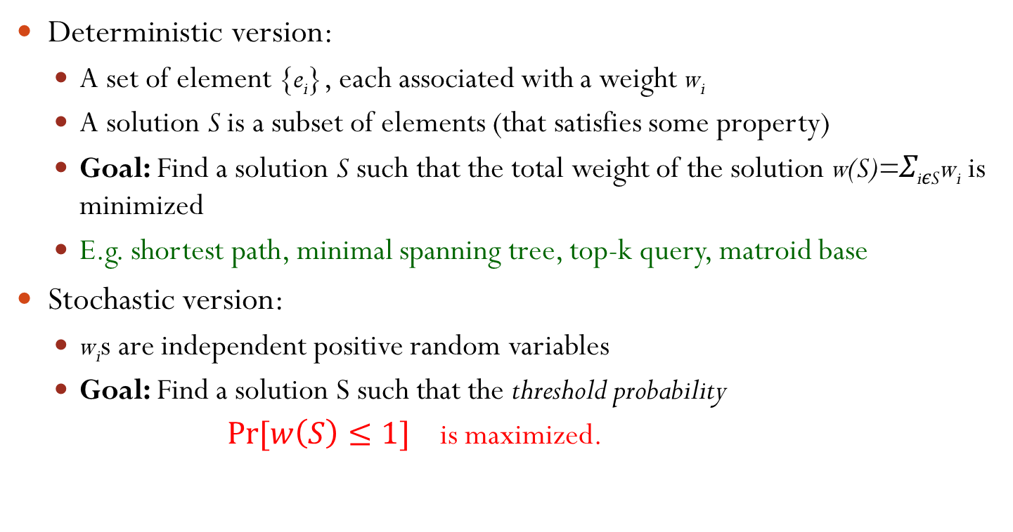
Threshold Probability Maximization
Deterministic version:
  A set of element {e_{i}}, each associated with a weight w_{i}
  A solution S is a subset of elements (that satisfies some property)
  Goal: Find a solution S such that the total weight of the solution w(S)=Σ_{iєS}w_{i} is minimized
  E.g. shortest path, minimal spanning tree, top-k query, matroid base
Stochastic version:
  w_{i}s are independent positive random variables
  Goal: Find a solution S such that the threshold probability
  $Pr⁡[w\left(S\right)≤1]$ is maximized.
Even computing the threshold prob is #P-hard in general!
FPTAS exists [Li, Shi, ORL’14]

Slide 31
Threshold Probability Maximization
Stochastic shortest path : find an s-t path P such that Pr[w(P)<1] is maximized
s
t

Slide 32
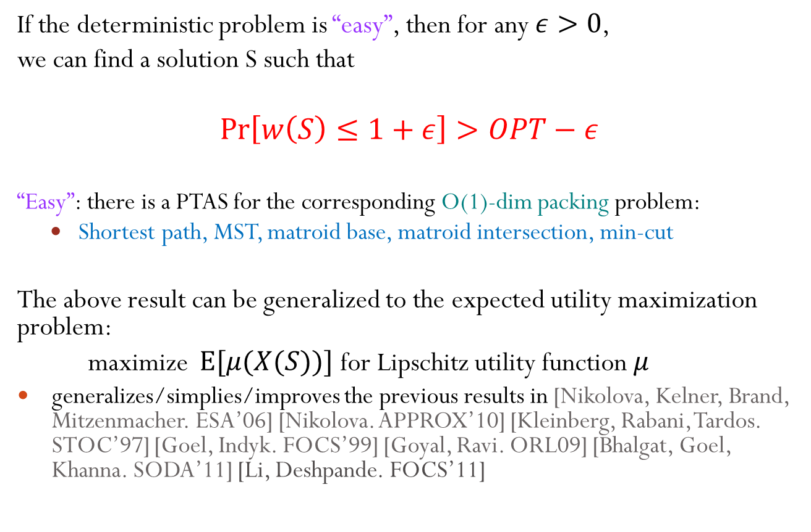
Our Result
If the deterministic problem is “easy”, then for any $ε>0$,
we can find a solution S such that
$$\operatorname{Pr}\left[w\left(S\right)≤1+ε\right]>OPT−ε$$
  “Easy”: there is a PTAS for the corresponding O(1)-dim packing problem:
  Shortest path, MST, matroid base, matroid intersection, min-cut
The above result can be generalized to the expected utility maximization problem:
maximize $E[μ(X(S))]$ for Lipschitz utility function $μ$
  generalizes/simplies/improves the previous results in [Nikolova, Kelner, Brand, Mitzenmacher. ESA’06] [Nikolova. APPROX’10] [Kleinberg, Rabani, Tardos. STOC’97] [Goel, Indyk. FOCS’99] [Goyal, Ravi. ORL09] [Bhalgat, Goel, Khanna. SODA’11] [Li, Deshpande. FOCS’11]

Slide 33
Our Results
Stochastic shortest path : find an s-t path P such that Pr[w(P)<1] is maximized
  Previous results
    Many heuristics
    Poly-time approximation scheme (PTAS) if (1) all edge weights are normally distributed r.v.s (2) OPT>0.5[Nikolova, Kelner, Brand, Mitzenmacher. ESA’06] [Nikolova. APPROX’10]
    Bicriterion PTAS (Pr[w(P)<1+δ]>(1-eps)OPT) for exponential distributions [Nikolova, Kelner, Brand, Mitzenmacher. ESA’06]
  Our result
    Bicriterion PTAS if OPT= Const
Uncertain length
s
t

Slide 34
Our Results
Stochastic knapsack (fixed set version): find a collection S of items such that Pr[w(S)<1]>γ and the total profit is maximized
  Previous results
    log(1/(1- γ))-approximation [Kleinberg, Rabani, Tardos. STOC’97]
    Bicriterion PTAS for exponential distributions [Goel, Indyk. FOCS’99]
    PTAS for Bernouli distributions if γ= Const [Goel, Indyk. FOCS’99] [Chekuri, Khanna. SODA’00]
    Bicriterion PTAS if γ= Const [Bhalgat, Goel, Khanna. SODA’11]
  Our result
    Bicriterion PTAS if γ= Const (with a better running time than Bhalgat et al.)
    Stochastic partial-ordered knapsack problem with tree constraints
Each item has a deterministic profit and a (uncertain) size
Knapsack, capacity=1
Notes:
Mention our algorithm is much simpler than [Bhalgat at al]

Slide 35
Algorithm2 (based on Poisson Approx)
Step 1: Discretizing the prob distr
  (Similar to [Bhalgat, Goel, Khanna. SODA’11], but much simpler)
Step 2: Reducing the problem to the multi-dim problem

Slide 36


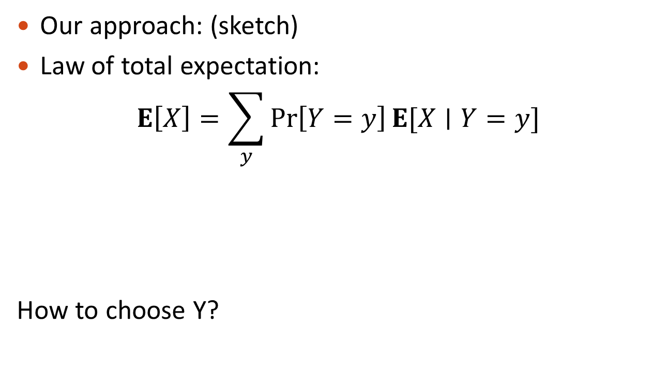

Algorithm2 (based on Poisson Approx)
Step 1: Discretizing the prob distr
  (Similar to [Bhalgat, Goel, Khanna. SODA’11], but simpler)
pdf of X_{i}
0
0
0
$$ε^{4}+ε^{5}$$
0
0
$$ε^{4}$$
$$ε^{4}+{2ε}^{5}$$
1
Discretized version: $\tilde{X_{i}}$
$$ε^{4}+ε^{5}$$
0
$$ε^{4}$$
$$ε^{4}+{2ε}^{5}$$
1

Slide 37

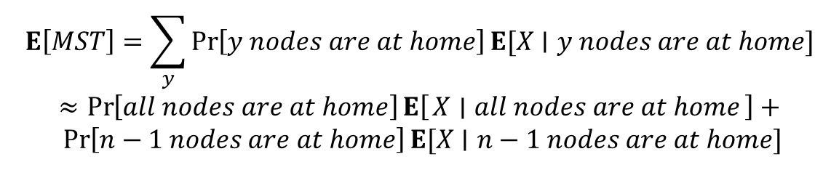
Algorithm2 (based on Poisson Approx)
Step 1: Discretizing the prob distr
  (Similar to [Bhalgat, Goel, Khanna. SODA’11], but simpler)
pdf of X_{i}
0
0
0
$$ε^{4}+ε^{5}$$
0
0
$$ε^{4}$$
$$ε^{4}+{2ε}^{5}$$
1
Discretized version: $\tilde{X_{i}}$
$$ε^{4}+ε^{5}$$
0
$$ε^{4}$$
$$ε^{4}+{2ε}^{5}$$
1
The behaviors of $\tilde{X_{i}}$ and $X_{i}$ are close:

Slide 38

Algorithm2 (based on Poisson Approx)
Step 2: Reducing the problem to the multi-dim problem
  Heavy items: E[X_{i}]>poly($ε$)
    At most O(1/poly($ε$)) many heavy items, so we can afford enumerating them

Slide 39
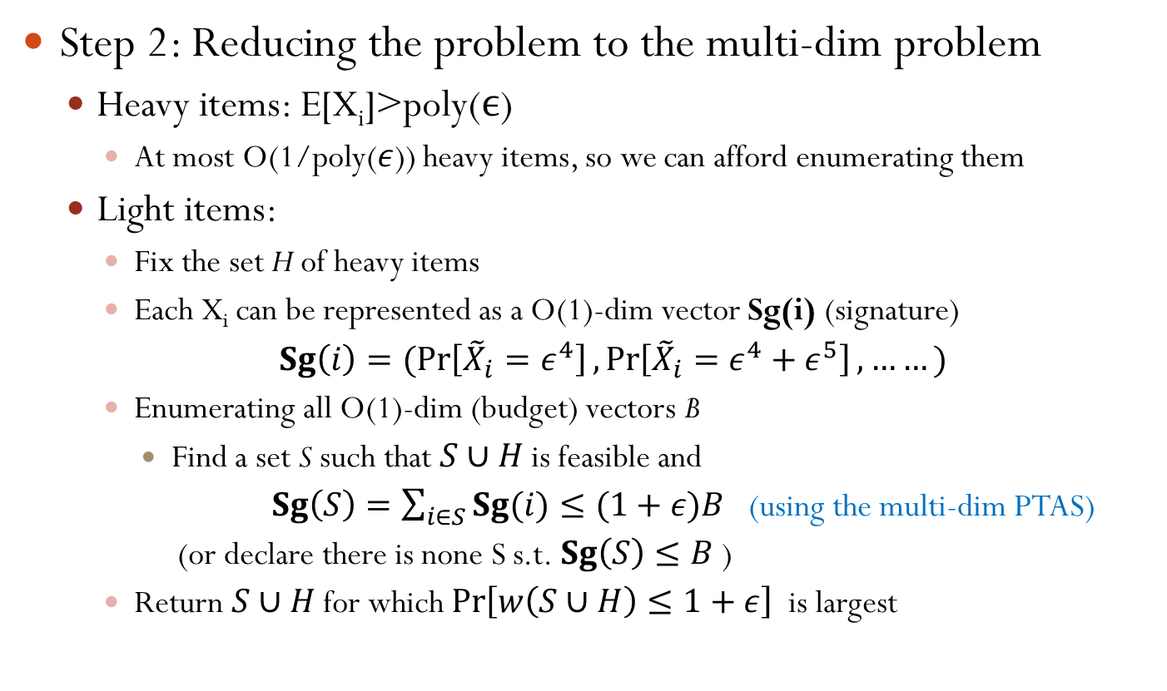
Algorithm2 (based on Poisson Approx)
Step 2: Reducing the problem to the multi-dim problem
  Heavy items: E[X_{i}]>poly($ϵ$)
    At most O(1/poly($ε$)) heavy items, so we can afford enumerating them
  Light items:
    Fix the set H of heavy items
    Each X_{i} can be represented as a O(1)-dim vector Sg(i) (signature)
    $Sg\left(i\right)=(\operatorname{Pr}\left[{\tilde{X}}_{i}=ε^{4}\right],\operatorname{Pr}\left[{\tilde{X}}_{i}=ε^{4}+ε^{5}\right], ……)$
    Enumerating all O(1)-dim (budget) vectors B
      Find a set S such that $S∪H$ is feasible and
      $Sg\left(S\right)=\sum_{i∈S}{Sg(i)}≤(1+ε)B$ (using the multi-dim PTAS)
      (or declare there is none S s.t. $Sg\left(S\right)≤B$ )
    Return $S∪H$ for which $\operatorname{Pr}\left[w\left(S∪H\right)≤1+ε\right]$ is largest

Slide 40
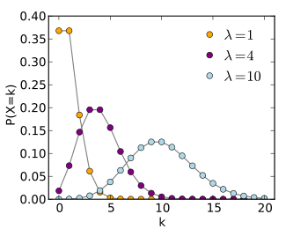

Poisson Approximation
Well known: Law of small numbers
n Bernoulli r.v. $X_{i}$ (1-p, p)
$np=const$
As $n→∞, ∑X_{i}∼Poisson(np)$

Slide 41
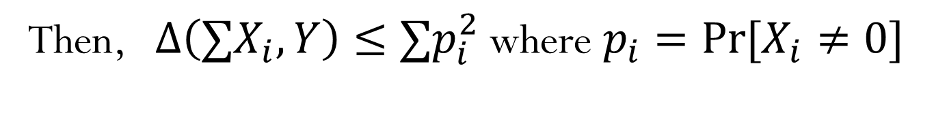
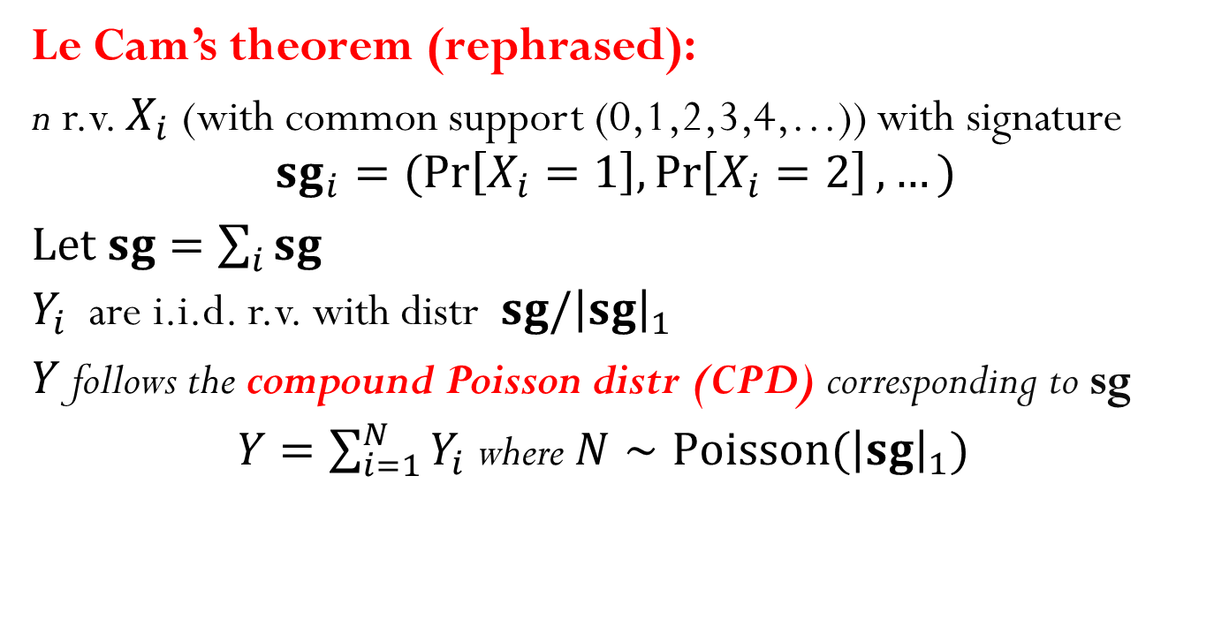
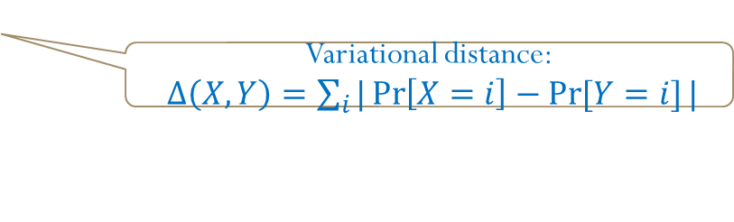
Poisson Approximation
Le Cam’s theorem (rephrased):
n r.v. $X_{i}$ (with common support (0,1,2,3,4,…)) with signature
$${sg}_{i}=(Pr\left[X_{i}=1\right],\operatorname{Pr}\left[X_{i}=2\right],…)$$
Let $sg=\sum_{i}{sg}$
$Y_{i}$ are i.i.d. r.v. with distr $sg/{\left|sg\right|}_{1}$
$Y$ follows the compound Poisson distr (CPD) corresponding to sg
$Y=\sum_{i=1}^{N}{Y_{i}}$ where $N∼Poisson({\left|sg\right|}_{1})$
Then, $Δ\left(∑X_{i}, Y\right)≤∑p_{i}^{2}$ where $p_{i}=\operatorname{Pr}{[X_{i}≠0]}$
Variational distance:
$Δ\left(X, Y\right)=\sum_{i}{|\operatorname{Pr}\left[X=i\right]−\operatorname{Pr}{[Y=i]}|}$

Slide 42
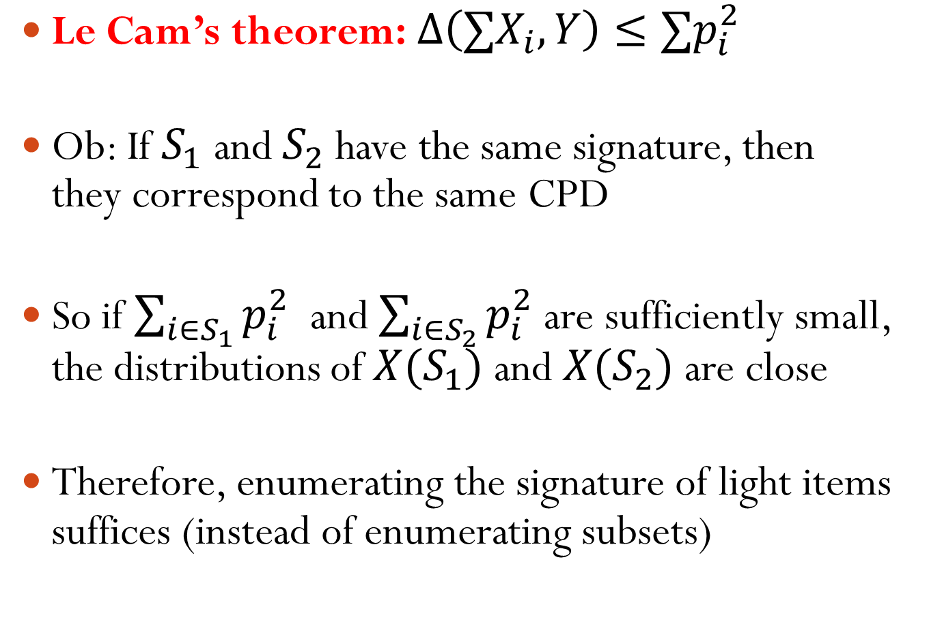
Poisson Approximation
$\text{Le} \text{Cam}\text{’}\text{s} \text{theorem}\text{:} Δ\left(∑X_{i}, Y\right)≤∑p_{i}^{2}$
Ob: If $S_{1}$ and $S_{2}$ have the same signature, then they correspond to the same CPD
So if $\sum_{i∈S_{1}}{p_{i}^{2}}$ and $\sum_{i∈S_{2}}{p_{i}^{2}}$ are sufficiently small, the distributions of $X(S_{1})$ and $X(S_{2})$ are close
Therefore, enumerating the signature of light items suffices (instead of enumerating subsets)

Slide 43


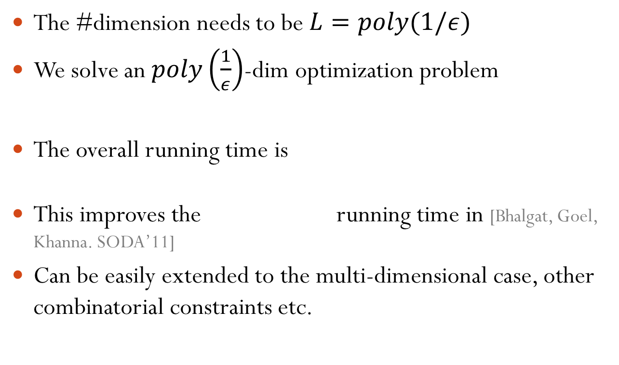
Summary
The #dimension needs to be $L=poly(1/ε)$
We solve an $poly\left(\frac{1}{ε}\right)$-dim optimization problem
The overall running time is
This improves the running time in [Bhalgat, Goel, Khanna. SODA’11]
Can be easily extended to the multi-dimensional case, other combinatorial constraints etc.

Slide 44
Outline
Stochastic Models
Classical Examples: E[MST]
Estimating E[MST] and other statistics
Stochastic Combinatorial Optimization: The Poisson Approximation Technique
    (Adaptive) Stochastic Knapsack
Expected Utility Maximization: The Fourier Decomposition Technique
Stochastic Matching: The Linear Programming Technique
Conclusion

Slide 45
Stochastic Knapsack
A knapsack of capacity C
A set of items, each having a fixed profit
Known: Prior distr of size of each item.
Each time we choose an item and place it in the knapsack irrevocably
The actual size of the item becomes known after the decision
Knapsack constraint: The total size of accepted items <= C
Goal: maximize E[Profit]
[L, Yuan STOC13]

Slide 46
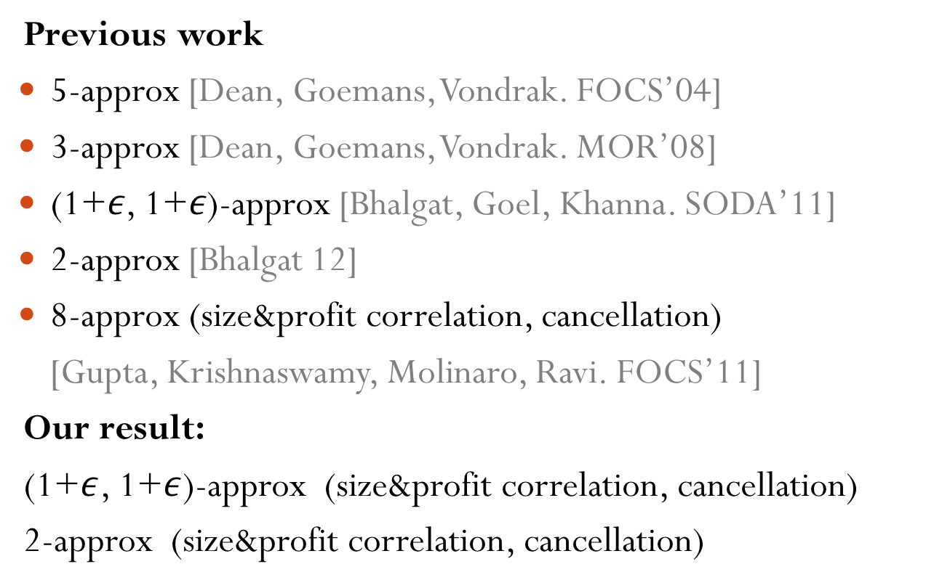
Stochastic Knapsack
Previous work
5-approx [Dean, Goemans, Vondrak. FOCS’04]
3-approx [Dean, Goemans, Vondrak. MOR’08]
(1+$ε$, 1+$ε$)-approx [Bhalgat, Goel, Khanna. SODA’11]
2-approx [Bhalgat 12]
8-approx (size&profit correlation, cancellation)
[Gupta, Krishnaswamy, Molinaro, Ravi. FOCS’11]
Our result:
(1+$ε$, 1+$ε$)-approx (size&profit correlation, cancellation)
2-approx (size&profit correlation, cancellation)

Slide 47




Stochastic Knapsack
Decision Tree
Item 1
Size=$ε$
Size=1-$ε$
Size=$3ε$
Size=$10ε$
Item 2
Item 3
Item 7
…..
Exponential size!!!! (depth=n)
How to represent such a tree? Compact solution?

Slide 48

Stochastic Knapsack
By discretization, we make some simplifying assumptions:
  Support of the size distribution: $（0,ε,2ε,3ε,……,1）$.
Still way too many possibilities, how to narrow the search space?

Slide 49
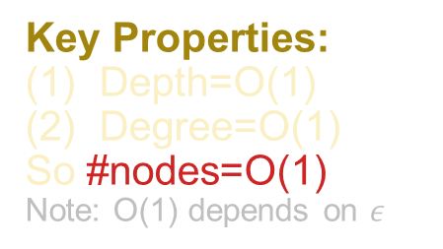
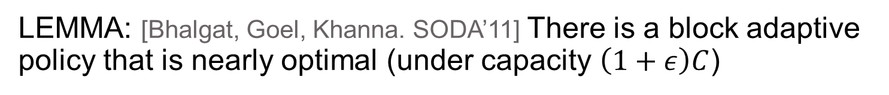
Block Adaptive Policies
Block Adaptive Policies: Process items block by block
Item 2
Item 3
Items 1,5,7
Key Properties:
Depth=O(1)
Degree=O(1)
So #nodes=O(1)
Note: O(1) depends on $ε$
Items 2,3
Items 3,6
Items 6,8,9
  LEMMA: [Bhalgat, Goel, Khanna. SODA’11] There is a block adaptive policy that is nearly optimal (under capacity $\left(1+ε\right)C$)

Slide 50
Block Adaptive Policies
Block Adaptive Policies: Process items block by block
Item 2
Item 3
Items 1,5,7
Key Properties:
Depth=O(1)
Degree=O(1)
So #nodes=O(1)
Note: O(1) depends on $ε$
Items 2,3
Items 3,6
Items 6,8,9
Still exponential many possibilities, even in a single block
  LEMMA: [Bhalgat, Goel, Khanna. SODA’11] There is a block adaptive policy that is nearly optimal (under capacity $\left(1+ε\right)C$)

Slide 51
Poisson Approximation
Each heavy item consists of a singleton block
Light items:
  Recall if two blocks have the same signature, their size distributions are similar
  So, enumerate Signatures! (instead of enumerating subsets)

Slide 52
Algorithm
Outline: Enumerate all block structures with a signature associated with each node
(0.4,1.1,0,…)
O(1) nodes
Poly(n) possible
signatures for each node
So total #configuration
=poly(n)
(5,1,1.7,2,…)
(0,0,1.5,2,…)
(1.1,1,1,1.5,…)
(0,1.4,1.2,2.1,…)
(1,1,2,…)
(0,1,1,2.2,…)

Slide 53
Algorithm
Find an assignment of items to blocks that matches all signatures
– (this can be done by standard dynamic program)

Slide 54
Algorithm
Find an assignment of items to blocks that matches all signatures
– (this can be done by standard dynamic programming)
Item 1
Item 2
Item 3
(0.4,1.1,0,…)
(0.1,0,0…..)
(0.2,0.04,0…..)
(0.15,0,0…..)
(5,1,1.7,2,…)
(0,0,1.5,2,…)
Item 4
Item 5
Item 6
(1.1,1,1,1.5,…)
(0,1.4,1.2,2.1,…)
(0.1,0.2,0.1…..)
(0.2,0.04,0.1…..)
(0.15,0.2,0.22…..)
(1,1,2,…)
(0,1,1,2.2,…)
On any root-leaf path, each item appears at most once

Slide 55
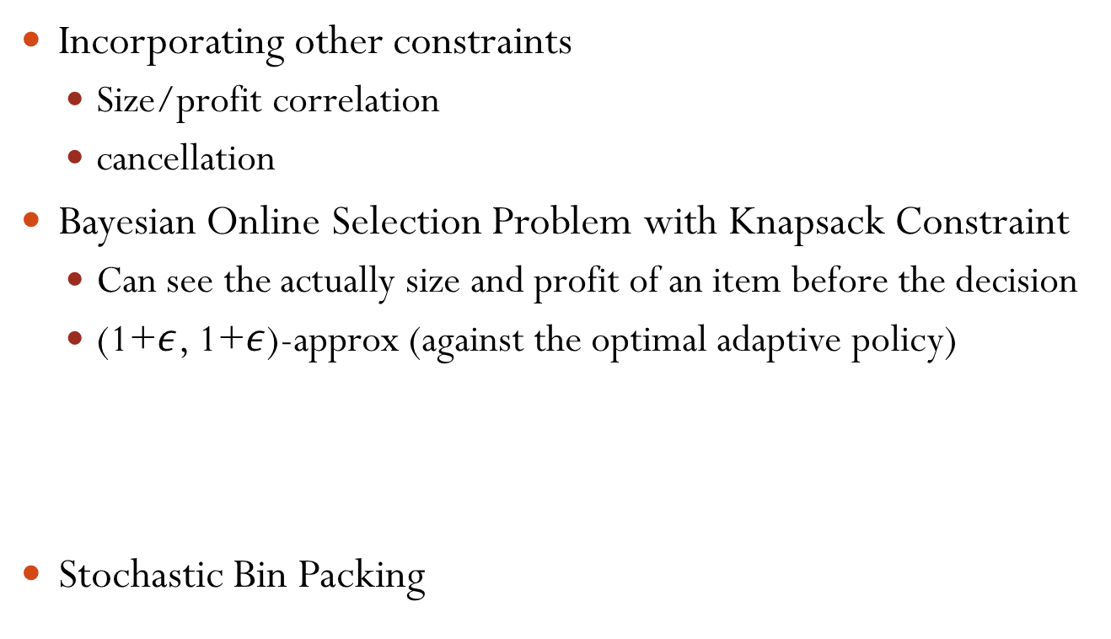
Poisson Approximation-Other Applications
Incorporating other constraints
  Size/profit correlation
  cancellation
Bayesian Online Selection Problem with Knapsack Constraint
  Can see the actually size and profit of an item before the decision
  (1+$ε$, 1+$ε$)-approx (against the optimal adaptive policy)
Stochastic Bin Packing
Prophet inequalities [Chawla, Hartline, Malec, Sivan. STOC10] [Kleinberg, Weinberg. STOC12]
Close relations with Secretary problems
Applications in multi-parameter mechanism design
[L, Yuan STOC13]

Slide 56
Outline
Stochastic Models
Classical Examples: E[MST]
Estimating E[MST] and other statistics
Stochastic Combinatorial Optimization: The Poisson Approximation Technique
Expected Utility Maximization: The Fourier Decomposition Technique
  Inadequacy of Expected Value
Stochastic Matching: The Linear Programming Technique
Conclusion

Slide 57
Inadequacy of Expected Value
Stochastic Optimization
  Some part of the input are probabilistic
  Most common objective: Optimizing the expected value
Inadequacy of expected value:
  Unable to capture risk-averse or risk-prone behaviors
    Action 1: $100 VS Action 2: $200 w.p. 0.5; $0 w.p. 0.5
    Risk-averse players prefer Action 1
    Risk-prone players prefer Action 2 (e.g., a gambler spends $100 to play Double-or-Nothing)

Slide 58
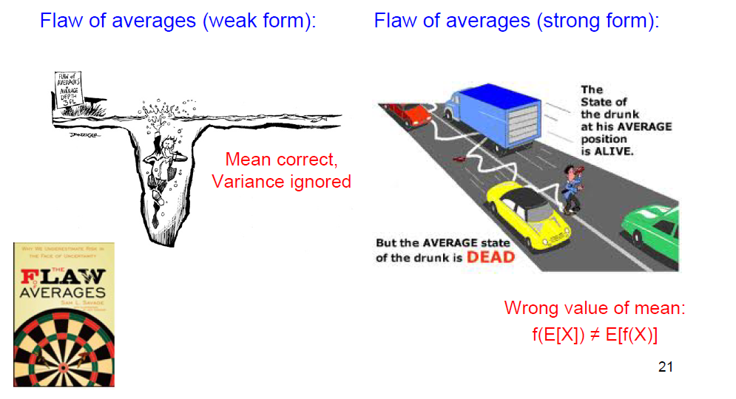
Inadequacy of Expected Value
Be aware of risk!
St. Petersburg Paradox

Slide 59
Outline
Stochastic Models
Classical Examples: E[MST]
Estimating E[MST] and other statistics
Stochastic Combinatorial Optimization: The Poisson Approximation Technique
Expected Utility Maximization: The Fourier Decomposition Technique
  Problem definition
Stochastic Matching: The Linear Programming Technique
Conclusion

Slide 60

Expected Utility Maximization Principle
Remedy: Use a utility function
Expected Utility Maximization Principle: the decision maker should choose the action that maximizes the expected utility
Proved quite useful to explain some popular choices that seem to contradict the expected value criterion
An axiomatization of the principle (known as von Neumann-Morgenstern expected utility theorem).

Slide 61
Problem Definition
Deterministic version:
  A set of element {e_{i}}, each associated with a weight w_{i}
  A solution S is a subset of elements (that satisfies some property)
  Goal: Find a solution S such that the total weight of the solution w(S)=Σ_{iєS}w_{i} is minimized
  E.g. shortest path, minimal spanning tree, top-k query, matroid base

Slide 62
Problem Definition
Deterministic version:
  A set of element {e_{i}}, each associated with a weight w_{i}
  A solution S is a subset of elements (that satisfies some property)
  Goal: Find a solution S such that the total weight of the solution w(S)=Σ_{iєS}w_{i} is minimized
  E.g. shortest path, minimal spanning tree, top-k query, matroid base
Stochastic version:
  w_{i}s are independent positive random variable
  μ(): R⁺→R⁺ is the utility function (assume lim_{x →∞}μ(x)=0)
  Goal: Find a solution S such that the expected utility E[μ(w(S))] is maximized

Slide 63
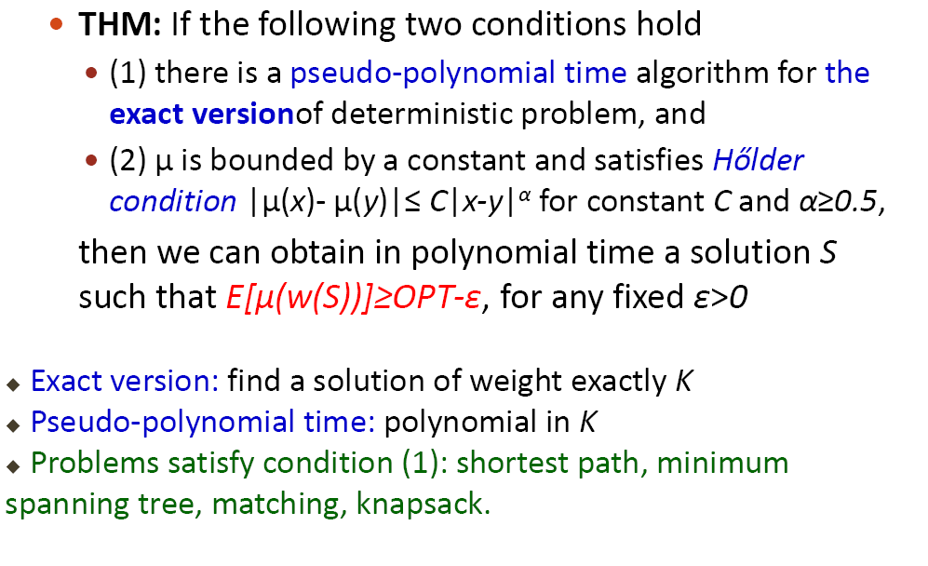
Our Results
THM: If the following two conditions hold
  (1) there is a pseudo-polynomial time algorithm for the exact versionof deterministic problem, and
  (2) μ is bounded by a constant and satisfies Holder condition |μ(x)- μ(y)|≤ C|x-y|^{α} for constant C and α≥0.5,
then we can obtain in polynomial time a solution S such that E[μ(w(S))]≥OPT-ε, for any fixed ε>0
Exact version: find a solution of weight exactly K
Pseudo-polynomial time: polynomial in K
Problems satisfy condition (1): shortest path, minimum spanning tree, matching, knapsack.

Slide 64
Our Results
If μ is a threshold function, maximizing E[μ(w(S))] is equivalent to maximizing Pr[w(S)<1]
  minimizing overflow prob. [Kleinberg, Rabani, Tardos. STOC’97] [Goel, Indyk. FOCS’99]
  chance-constrained stochastic optimization problem [Swamy. SODA’11]
1
μ(x)
0
1

Slide 65
Our Results
If μ is a threshold function, maximizing E[μ(w(S))] is equivalent to maximizing Pr[w(S)<1]
  minimizing overflow prob. [Kleinberg, Rabani, Tardos. STOC’97] [Goel, Indyk. FOCS’99]
  chance-constrained stochastic optimization problem [Swamy. SODA’11]
However, our technique can not handle discontinuous function directly
So, we consider a continuous version μ’
1
μ(x)
1
μ'(x)
0
1
0
1
1+δ

Slide 66
Our Results
Other Utility Functions
Exponential

Slide 67
Outline
Stochastic Models
Classical Examples: E[MST]
Estimating E[MST] and other statistics
Stochastic Combinatorial Optimization: The Poisson Approximation Technique
Expected Utility Maximization: The Fourier Decomposition Technique
  Algorithm and analysis
Stochastic Matching: The Linear Programming Technique
Conclusion

Slide 68
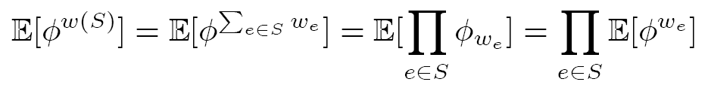
Our Algorithm
Observation: We first note that the exponential utility functions are tractable

Slide 69


Our Algorithm
Observation: We first note that the exponential utility functions are tractable
Approximate the expected utility by a short linear sum of exponential utility
  Show that the error can be bounded by є

Slide 70
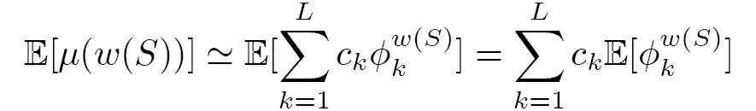
Our Algorithm
Observation: We first note that the exponential utility functions are tractable
Approximate the expected utility by a short linear sum of exponential utility
  Show that the error can be bounded by є
By linearity of expectation

Slide 71
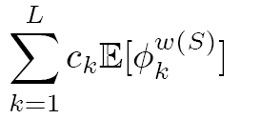
Our Algorithm
Problem: Find a solution S minimizing

Slide 72
Our Algorithm
Problem: Find a solution S minimizing
Suffices to find a set S such that
Opt

Slide 73

Our Algorithm
Problem: Find a solution S minimizing
Suffices to find a set S such that
(Approximately) Solve the multi-objective optimization problem with objectives for k=1,…,L
Opt

Slide 74
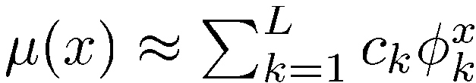
Approximating Utility Functions
How to approximate μ() by a short sum of exponentials?
(with lim μ(x)->0 )

Slide 75
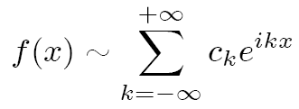

Approximating Utility Functions
How to approximate μ() by a short sum of exponentials?
(with lim μ(x)->0 )
A scheme based on Fourier Series decomposition:
For a periodic function f(x) with period 2¼
where the Fourier coefficient

Slide 76

Approximating Utility Functions
How to approximate μ() by a short sum of exponentials?
(with lim μ(x)->0 )
A scheme based on Fourier Series decomposition:
For a periodic function f(x) with period 2¼
where the Fourier coefficient
Consider the partial sum (L=2N+1)

Slide 77
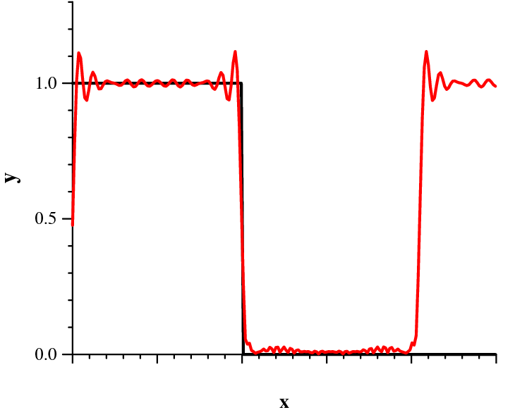
Approximating The Threshold Function
Need L=poly(1/²) terms
y=¹(x)
Partial Fourier Series
Periodic !
Gibbs Phenomenon

Slide 78
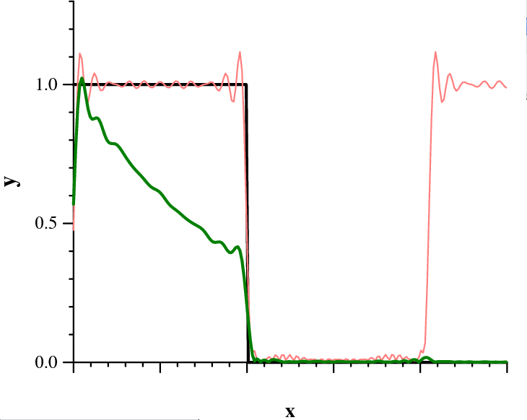

Approximating The Threshold Function
y=¹(x)
Partial Fourier Series
Periodic !
Damping Factor :
Biased approximation

Slide 79
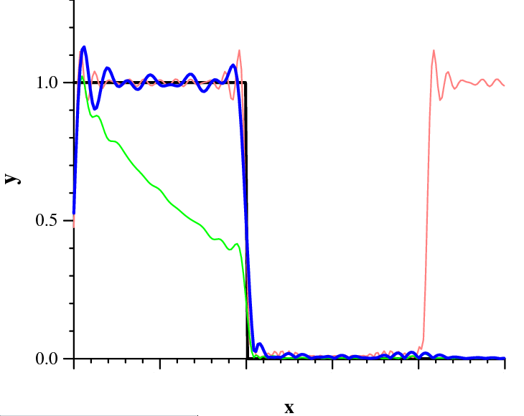

Approximating The Threshold Function
y=¹(x)
Partial Fourier Series
Periodic !
Damping Factor :
Biased approximation
Initial Scaling :
Unbiased
Apply Fourier series expansion on

Slide 80
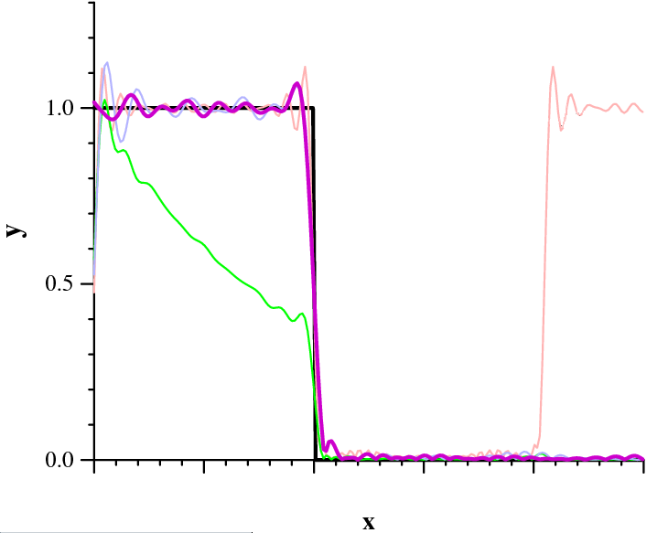
Approximating The Threshold Function
y=¹(x)
Partial Fourier Series
Periodic !
Damping Factor :
Biased approximation
Initial Scaling :
Unbiased
Extending the func.
Unbiased and better
quality around origin

Slide 81

The Multi-objective Optimization
Want to find a set S such that
(Approximately) Solve the multi-objective optimization problem with objectives for i=1,…,L
(Similar to [Papadimitriou, Yannakakis FOCS’00])
Each element e has a multi-dimensional weight

Slide 82


The Multi-objective Optimization
Discretize the vector
Enumerate all possible 2L-dimensional vector A (poly many)
  Think A as the approximate version of
Check if there is any feasible solution S such that
  We use the pseudo-poly algorithm for the exact problem

Slide 83
Summary
We need L=poly(1/²) terms
We solve an O(L) dim optimization problem
The overall running time is
This improves the running time in [Bhalgat, Goel, Khanna. SODA’11]

Slide 84



Extension: Multi-dimensional Weights
Stochastic Multidimensional Knapsack:
Each element e is associated with a random vector
(entries can be correlated) d =O(1)
Each element e is associated with a profit p_{e}
Objective: Find a set S of items such that
and the total profit is maximized
Our result: We can find a set S of items in poly time such that the total profit is at least (1-²) of the optimum and

Slide 85


Extension: Multi-dimensional Weights
Consider the 2-dimensional utility function
Consider the rectangular partial sum of the 2d Fourier series expansion
A continuous version of the 2d threshold function

Slide 86
Discussion
Other problems in P? min-cut, matroid base
  There is no pseudo-poly time algorithm for EXACT-min-cut
    Why? EXACT-min-cut is strongly NP-hard (harder than MAX-CUT)
  It is a long standing open problem whether there is a pseudo-poly-time algo for EXACT-matroid base
Can we get the same result for these problems?
  Not for min-cut
  Consider a deterministic instance where MAX-CUT=1
μ
1
0.878

Slide 87
Discussion
(1) Monotone and Lipschitz nonincreasing utility function
(2) [LY’13] PTAS for the deterministic multi-dimensional version
then we can obtain S such that
E[μ(w(S))]≥OPT-ε,
for any fixed ε>0.
Deterministic multi-dimensional version:
Each edge e has a weight (const dim) vector v_{e}.
Given a target vector V, find a feasible set S s.t. v(S)<=V
A PTAS should
  either return a feasible set S such that v(S)<=(1+ε)V
  or claim that there is no feasible set S such that v(S)<=V

Slide 88
Discussion
KNOWN:
Pseudo-poly for EXACT-A => PTAS for MulDim-A
[Papadimitriou, Yannakakis FOCS’00]
PTAS for MulDim-MinCut [Armon, Zwick Algorithmica06]
PTAS for MulDim-Matroid Base [Ravi, Goemans SWAT96]
PTAS for MulDim
Pseudo-poly for EXACT
Min-cut
Shortest path, Matching, MST, Knapsack
Matroid base?

Slide 89

Open Problems
OPEN: Can we extend the technique to the adaptive problem (considered in [Dean,Geomans,Vondrak, FOCS’04 ] [Bhalgat, Goel, Khanna. SODA’11])?
OPEN: Can we get a PTAS? (with a multiplicative error)
  Even for optimizing the overflow probability
Consider maximization problems and increasing utility functions
Optimizing or
  For and , see [Kleinberg, Rabani, Tardos. STOC’97], [Goel, Guha, Munagala PODS’06]

Slide 90
Outline
Stochastic Models
Classical Examples: E[MST]
Estimating E[MST] and other statistics
Stochastic Combinatorial Optimization: The Poisson Approximation Technique
Expected Utility Maximization: The Fourier Decomposition Technique
Stochastic Matching: The Linear Programming Technique
Conclusion

Slide 91
Problem Definition
Stochastic Matching [Chen, Immorlica, Karlin, Mahdian, and Rudra. ’09]
Given:
  A probabilistic graph G(V,E).
  Existential prob. p_{e} for each edge e.
  Patience level t_{v} for each vertex v.
Probing e=(u,v): The only way to know the existence of e.
  We can probe (u,v) only if t_{u}>0, t_{v}>0 .
  If e indeed exists, we should add it to our matching.
  If not, t_{u} =t_{u}-1 , t_{v} =t_{v}-1.

Slide 92
Problem Definition
Output: A strategy to probe the edges
  Edge-probing: an (adaptive or non-adaptive) ordering of edges.
  Matching-probing: k rounds; In each round, probe a set of disjoint edges
Objectives:
  Unweighted: Max. E[ cardinality of the matching].
  Weighted: Max. E[ weight of the matching].

Slide 93

Motivations
Online dating
  Existential prob. p_{e} : estimation of the success prob. based on users’ profiles.

Slide 94


Motivations
Online dating
  Existential prob. p_{e} : estimation of the success prob. based on users’ profiles.
  Probing edge e=(u,v) : u and v are sent to a date.

Slide 95

Motivations
Online dating
  Existential prob. p_{e} : estimation of the success prob. based on users’ profiles.
  Probing edge e=(u,v) : u and v are sent to a date.
  Patience level: obvious.

Slide 96

Motivations
Kidney exchange
  Existential prob. p_{e} : estimation of the success prob. based on blood type etc.
  Probing edge e=(u,v) : the crossmatch test (which is more expensive and time-consuming).

Slide 97
Our Results
Previous results for unweighted version [Chen et al. ’09]:
  Edge-probing: Greedy is a 4-approx.
  Matching-probing: O(log n)-approx.
A simple 8-approx. for weighted stochastic matching.
  For edge-probing model.
  Can be generalized to set packing.
An improved 3-approx. for bipartite graphs and 4-approx. for general graphs based on dependent rounding [Gandhi et al. ’06].
  For both edge-probing and matching-probing models.
  This implies the gap between the best matching-probing strategy and the best edge-probing strategy is a small const.

Slide 98
Our Results
Previous results for unweighted version [Chen et al. ’09]:
  Edge-probing: Greedy is a 4-approx.
  Matching-probing: O(log n)-approx.
A simple 8-approx. for weighted stochastic matching.
  For edge-probing model.
  Can be generalized to set/hypergraph packing.
An improved 3-approx. for bipartite graphs and 4-approx. for general graphs based on dependent rounding [Gandhi et al. ’06].
  For both edge-probing and matching-probing models.
  This implies the gap between the best matching-probing strategy and the best edge-probing strategy is a small const.

Slide 99
Our Results
Previous results for unweighted version [Chen et al. ’09]:
  Edge-probing: Greedy is a 4-approx.
  Matching-probing: O(log n)-approx.
A simple 8-approx. for weighted stochastic matching.
  For edge-probing model.
  Can be generalized to set/hypergraph packing.
An improved 3-approx. for bipartite graphs and 4-approx. for general graphs based on dependent rounding [Gandhi et al. ’06].
  For both edge-probing and matching-probing models.
  This implies the gap between the best matching-probing strategy and the best edge-probing strategy is a small const.

Slide 100










Stochastic online matching
1
1
1
1
1
A set of items and a set of buyer types. A buyer of type b likes item a with probability p_{ab}.
  G(buyer types, items): Expected graph)
The buyers arrive online.
  Her type is an i.i.d. r.v. .
The algorithm shows the buyer (of type b) at most t items one by one.
The buyer buys the first item she likes or leaves without buying.
Goal: Maximizing the expected number of satisfied users.
0.9
0.2
0.6
0.5
1
0.9
0.2
0.9
Expected graph

Slide 101

Stochastic online matching
  This models the online AdWords allocation problem.
  This generalizes the stochastic online matching problem of [Feldman et al. ’09, Bahmani et al. ’10, Saberi et al ’10] where p_{e}={0,1}.
  We have a 4.008-approximation.

Slide 102
Approximation Ratio
We compare our solution against the optimal (adaptive) strategy (not the offline optimal solution).
An example:
…
p_{e=}1/n
t=1
E[offline optimal] = 1-(1-1/n)^{n} ≈ 1-1/e
E[any algorithm] = 1/n

Slide 103


A LP Upper Bound
Variable y_{e} : Prob. that any algorithm probes e.
At most 1 edge in ∂(v) is matched
At most t_{v} edges in ∂(v) are probed
x_{e}: Prob. e is matched

Slide 104
A Simple 8-Approximation
An edge (u,v) is safe if t_{u}>0, t_{v}>0 and neither u nor v is matched
Algorithm:
Pick a permutation π on edges uniformly at random
For each edge e in the ordering π, do:
  If e is not safe then do not probe it.
  If e is safe then probe it w.p. y_{e}/α.

Slide 105



A Simple 8-Approximation
Analysis:
Lemma: For any edge (u,v), at the point when (u,v) is considered under π, Pr(u loses its patience) ≤1/2α .
Proof: Let U be #probes incident to u and before e.
By the Markov inequality:

Slide 106



A Simple 8-Approximation
Analysis:
Lemma: For any edge e=(u,v), at the point when (u,v) is considered under π, Pr(u is matched) ≤1/2α .
Proof: Let U be #matched edges incident to u and before e.
By the Markov inequality:

Slide 107

A Simple 8-Approximation
Analysis:
Theorem: The algorithm is a 8-approximation.
Proof: When e is considered,
Pr(e is not safe) ≤ Pr(u is matched)+ Pr(u loses its patience)+
Pr(v is matched)+ Pr(v loses its patience)
≤ 2/α
Therefore,
Recall Σ_{e} w_{e} y_{e} p_{e} is an upper bound of OPT

Slide 108

An Improved Approx. – Bipartite Graphs
Algorithm:
y ← Optimal solution of the LP.
y’ ← Round y to an integral solution using dependent rounding [Gandhi et al. 06] and Let E’= {e | y’_{e}=1}.
  (Marginal distribution) Pr(y’_{e}=1)=y_{e};
  (Degree preservation) Deg_{E’}(v) ≤ t_{v} ; (Recall Σ_{e in} _{∂(v)} y_{e} ≤ t_{v} )
  (Negative Correlation).
Probe the edges in E’ in random order.
for any
For matching-probe model:
M₁, …, M_{h} ← Optimal edge coloring of E’.
Probe {M₁, …,M_{h}} in random order.

Slide 109


An Improved Approx. – Bipartite Graphs
Analysis (sketch):
We show Pr[e is probed] >= O(1)y_{e}
Assume we have chosen E’.
Consider a particular edge e=(u,v).
Let B(e,π) be the set of incident edges that appear before e in the random order π.
We claim that

Slide 110


An Improved Approx. – Bipartite Graphs
Analysis cont: To see
Consider this random experiment: For each edge in , ,we pick a random real a_{e} in [0,1]. This produces a uniformly random ordering. Let r.v. A_{f}= (1-p_{f}) if f goes before e, and A_{f}=1 o.w.
Then, we consider

Slide 111



An Improved Approx. – Bipartite Graphs
Analysis cont:
Define to be the optimal value of
We can show is convex and
decreasing on r
minimize

Slide 112


An Improved Approx. – Bipartite Graphs
Analysis cont:
Marginal Prob.
If p_{max} is 1, =3.

Slide 113
An Improved Approx. – Bipartite Graphs
Analysis cont:
Marginal Prob.
Convexity.
If p_{max} is 1, =3.

Slide 114
An Improved Approx. – Bipartite Graphs
Analysis cont:
Marginal Prob.
Convexity.
Negative correlation.

Slide 115
An Improved Approx. – General Graphs
Algorithm:
(x,y) ← Optimal solution of the LP.
Randomly partition vertices into A and B.
Run the previous algorithm on the bipartite graph G(A,B).
Thm: It is a 2/ρ(1)-approximation.
If p_{max} → 1, the ratio tends to 4. If p_{max} → 0, the ratio tends to 2/(1-1/e) ≈3.15

Slide 116
Final Remarks and Open Questions
Recently, Adamczyk has proved that the greedy algorithm is a 2-approximation for the unweighted version.
Better approximations? (Unweighted: 2; Weighted bipartite: 3; Weighted: 4).
Can we get anything better than 2 (even without patience parameter)?
  We recently obtained a PTAS if G is a tree
Hardness? Any lower bound?

Slide 117
Conclusion
Replacing the input random variable with its expectation typically is NOT the right thing to do
  Carry the randomness along the way and optimize the expectation of the objective
We can often reduce the stochastic optimization problem (with independent random variables) to a constant dimensional packing problem
Stochastic optimization problems with dependent random variables are typically extremely hard (i.e., inapproximable)
Many interesting problems in the stochastic models

Slide 118
Many Other Problems
Stochastic geometry models
  Nearest neighbor queries [Afshani, Agarwal, Arge, Larsen, Phillips. ‘11]
  Range queries [Li, Wang ‘14] [Agarwal, Har-Peled, Suri, Yıldız, Zhang 14]
  Coresets [Abdullah, Daruki, Phillips ‘13] [Huang, Li, Phillips, Wang ‘15]
  Shape fitting (minimum enclosing ball, cylinder etc.) [Feldman, Munteanu, Sohler 14] [Huang, Li, Phillips, Wang ‘15]

Slide 119
Thanks
lijian83@mail.tsinghua.edu.cn

