Slide 1
Attentions II
Jian Li
Tsinghua University

Slide 2
Seq2seq without RNN?? ConvS2S: convolutional seq2seq convolution+attention
Convolutional Sequence to Sequence Learning

Slide 3
a 100% convolutional architecture to represent hierarchical representation of input sequence.
The crux is that close input elements interact at lower layers while distant interacts at higher layers.

Slide 4
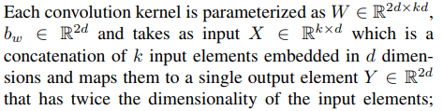

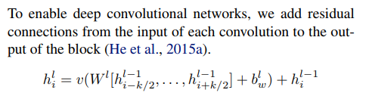


Convolution filter
Overall encoder-decoder structure
(see later)
Output of the decoder
Output of the encoder
K*d
2d
Nonlinearity: Gated linear unit
Pointwise multiplication
$σ(B)$ control which part of A is relevant

Slide 5

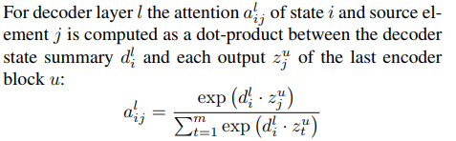
Multi-step attention
attention mechanism for each decoder layer.
Decoder state i summary:
Parameter matrix
Current decoder state
Parameter vector
Previous target element
Output of the decoder
Output of the encoder

Slide 6
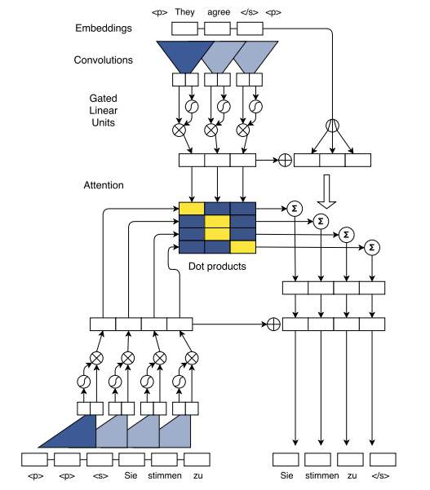
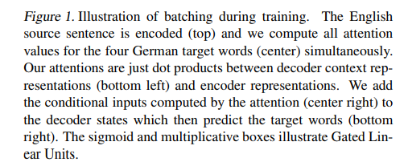



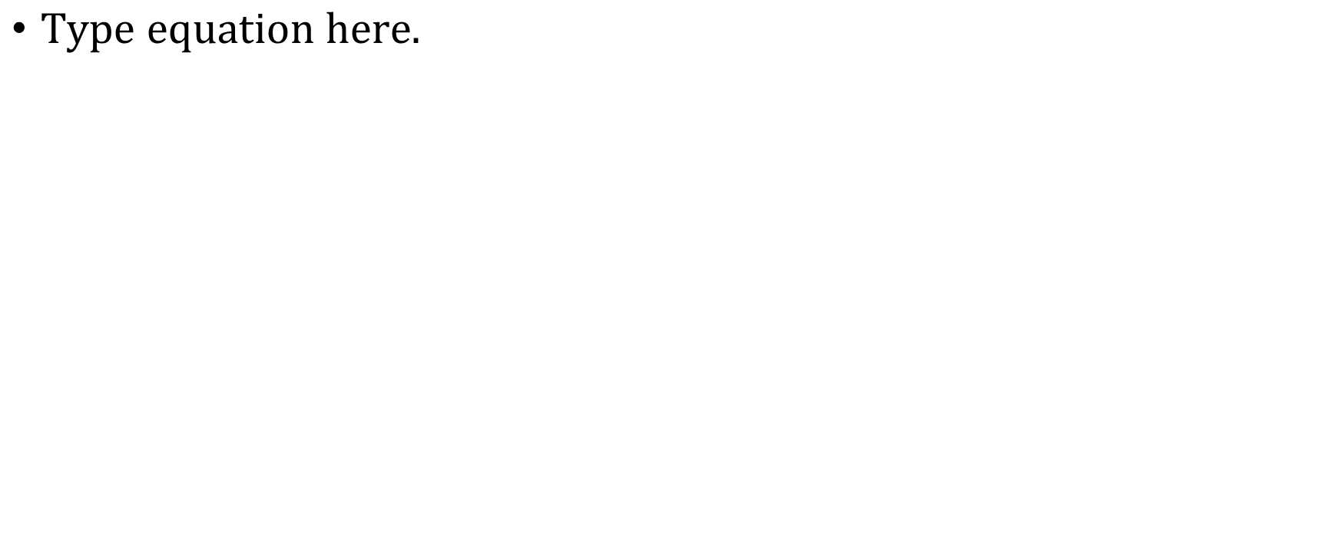


$$e_{j}$$
conditional input
$e_{j}$:element input embedding
$$c_{i}^{l}:added to h_{i}^{l}$$
padding
Training phase

Slide 7

$$e_{j}$$
$e_{j}$:element input embedding
$$c_{i}^{l}:added to h_{i}^{l}$$
final layer of the decoder just before the softmax
Thera are L convolutional layer
Output:
padding
In testing: Second
place this word here
Testing:
First produce this word

Slide 8
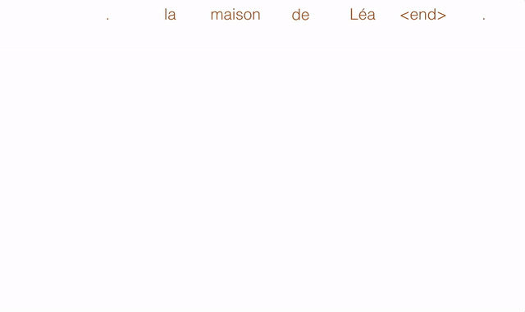
Multi-step attention (in testing)
In particular, the attention of the first layer determines a useful source context which is then fed to the second layer that takes this information into account when computing attention etc.
The decoder also has immediate access to the attention history of the k − 1 previous time steps because the conditional inputs

Slide 9
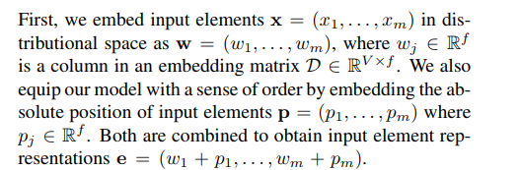
A trick: positional embedding
capturing a sense of order in a sequence
This encoding gives the model a sense of which portion of the sequence of the input (or output) it is currently dealing with. The positional encoding can be learned, or fixed. Authors made tests (PPL, BLEU) showing that both: learned and fixed positional encodings perform similarly.

Slide 10
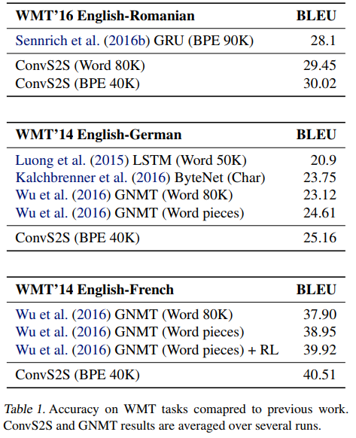

Slide 11
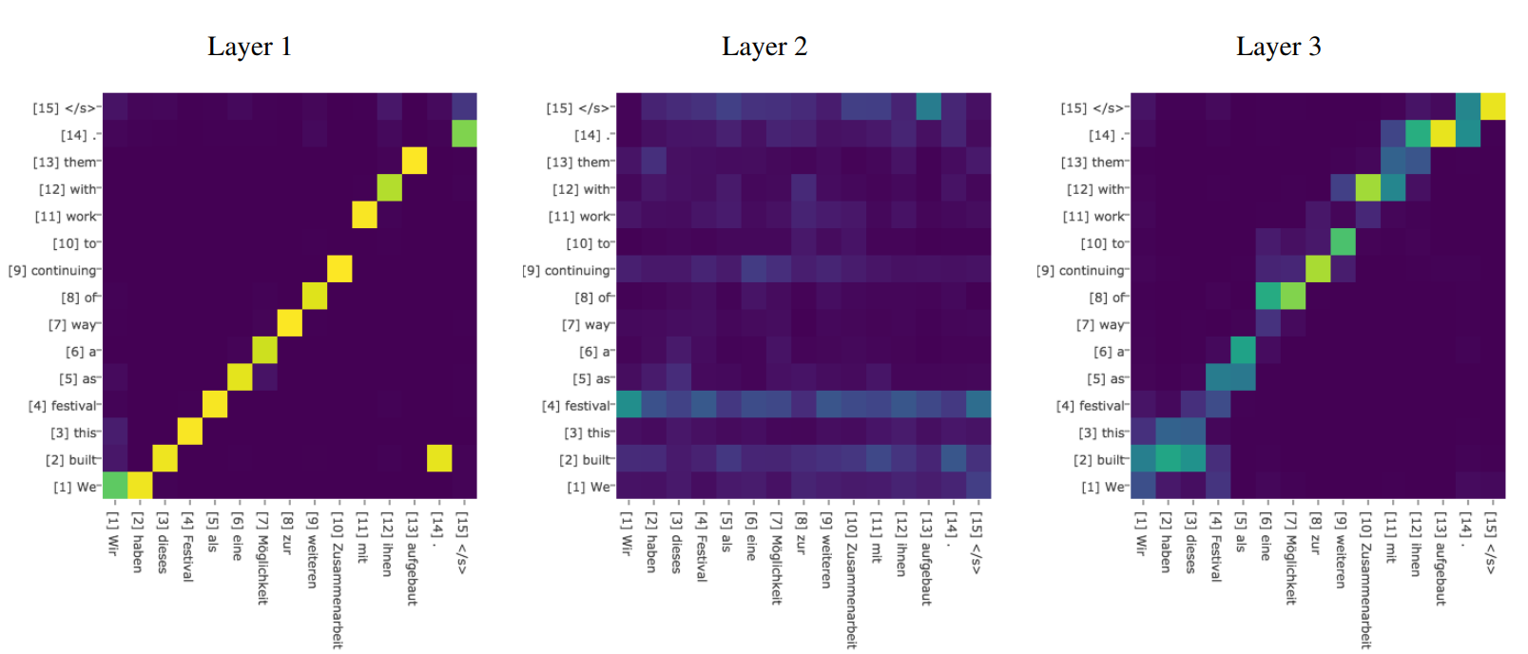
Attention scores for different decoder layers for a sentence translated from English (y-axis) to German (x-axis). This model uses 8 decoder layers and a 80k BPE vocabulary

Slide 12
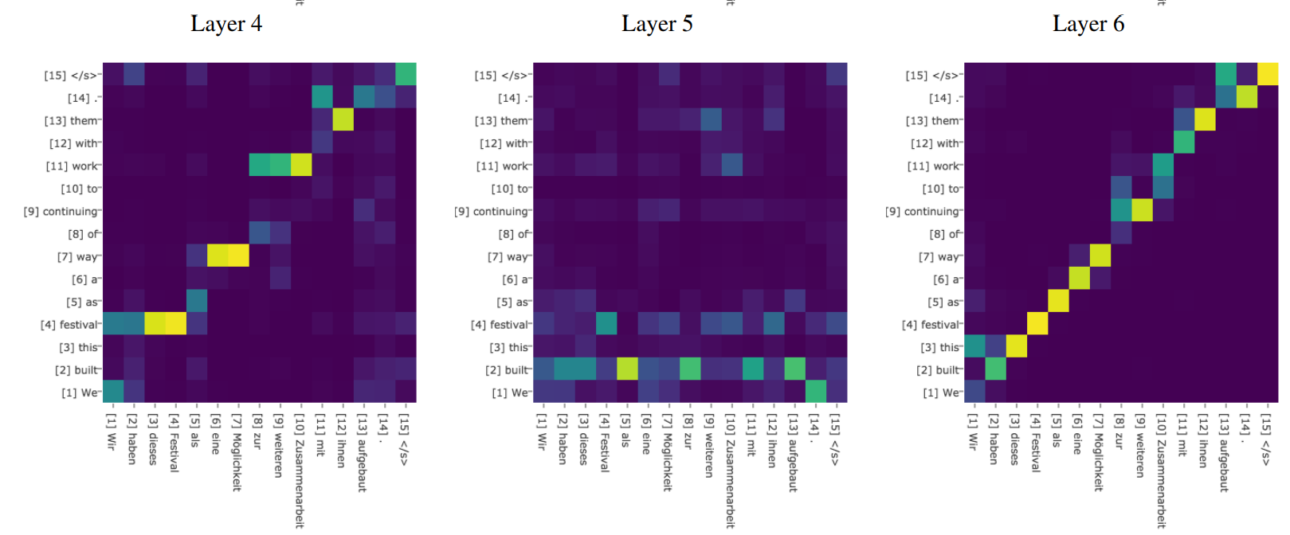

Slide 13
Tranformer: Attention is all you need

Slide 14
Seq2Seq
RNN:
Advantages: are popular and successful for variable-length representations such as sequences (e.g. languages), images, etc. RNN are considered core of seq2seq (with attention). The gating models such as LSTM or GRU are for long-range error propagation.
Problems: The sequentiality prohibits parallelization within instances. Long-range dependencies still tricky, despite gating. Sequence-aligned states in RNN are wasteful. Hard to model hierarchical-alike domains such as languages.
CNN:
Advantages: Trivial to parallelize (per layer) and fit intuition that most dependencies are local.
Problems: Path length between positions can be logarithmic when using dilated convolutions, left-padding for text. (autoregressive CNNs WaveNet, ByteNET )
Some material from https://mchromiak.github.io/articles/2017/Sep/12/Transformer-Attention-is-all-you-need/#.WtstO3puaUl

Slide 15
Tranformer:
Solution: Multi-head self-attention mechanism.
Why attention? Table 2 of the paper (later) shows that such attention networks can save 2–3 orders of magnitude of operations!
Objective
Parallelization of Seq2Seq: RNN/CNN handle sequences word-by-word sequentially which is an obstacle to parallelize. Transformer achieve parallelization by replacing recurrence with attention and encoding the symbol position in sequence. This in turn leads to significantly shorter training time.
Reduce sequential computation: Constant O(1) number of operations to learn dependency between two symbols independently of their position distance in sequence.

Slide 16
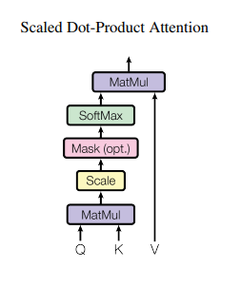

Key Value Attention
The input consists of queries and keys of dimension dk, and values of dimension dv
Q: queries
K: keys
V: values
dk
#(key, value) pair
dv
dv
#queries
Q
K
#(key, value)
V
#queries
Result
For each query, return the most relevant (linear combination) value.
Relevance determined by <query, key>

Slide 17
Key Value Attention
The input consists of queries and keys of dimension dk, and values of dimension dv
Q: queries
K: keys
V: values
dk
#(key, value) pair
dv
dv
Mask
#queries
Q
K
#(key, value)
V
#queries
Result
Mask
masking out (setting to −∞) all values in the input of the softmax which correspond to illegal connections

Slide 18
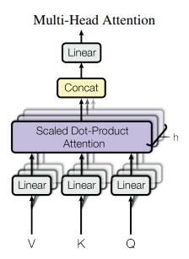
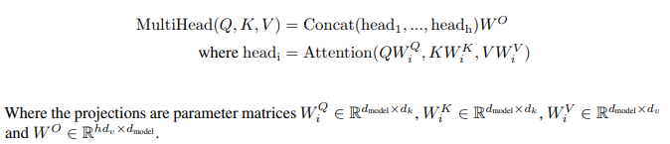
Multi-head attention
h = 8 parallel attention layers, or heads
dmodel = 512.
dk = dv = dmodel/h = 64.

Slide 19
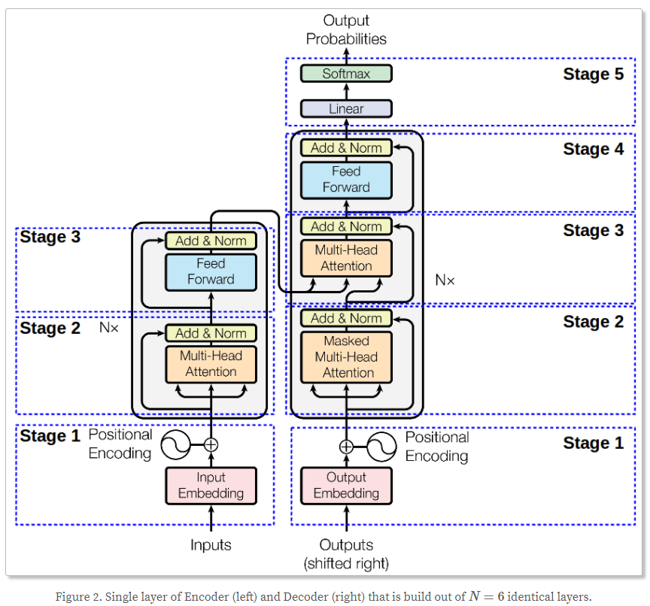
Encoder：
Stage 1 – Encoder Input
Stage 2 – Multi-head attention
Stage 3 – position-wise FFN
Stages 2 and 3 use the residual connection
Decoder：
Stage 1 – Decoder input
Stage 2 Masked Multi-head attention
Modified to prevent positions to attend to subsequent positions.
Stage 3 – Multi-head attention
Stage 4 – position-wise FFN
Stages 2, 3 and 4 also use the residual connection followed by normalization layer at its output.

Slide 20
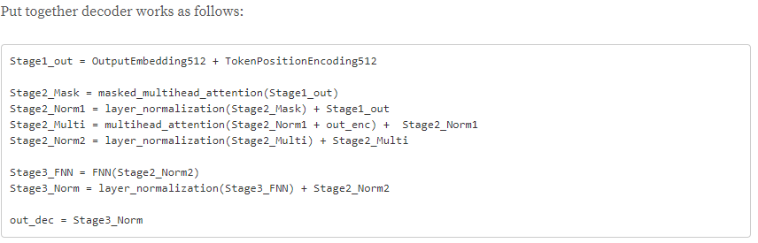
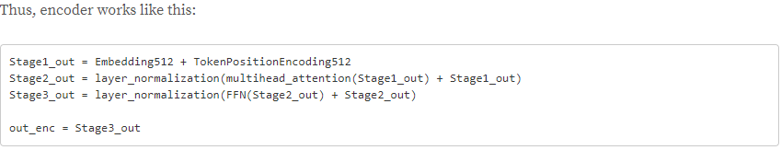

Slide 21
Masked Multi-head attention
We also modify the self-attention sub-layer in the decoder stack to prevent positions from attending to subsequent positions. This masking, combined with fact that the output embeddings are offset by one position, ensures that the predictions for position i can depend only on the known outputs at positions less than i.
masking out (setting to −∞) all values in the input of the softmax which correspond to illegal connections

Slide 22


Positional embedding
Fixed positional embedding
Feed Forward Network
i: indicates the frequency
The wavelengths form a geometric progression from 2π to 10000 · 2π

Slide 23
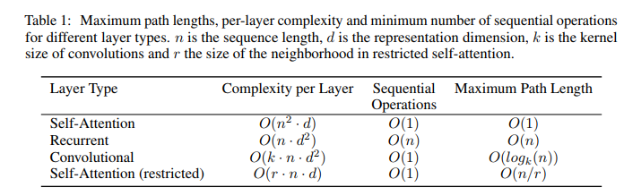
Why use self-attention
self-attention layer enable each position to attend to all previous positions in the decoder, including the current position.
use of self-attention layers instead of recurrent or convolutional layers
self-attention layers connects all positions with O(1) number of sequentially executed operations (eg. vs O(n) in RNN)
Minimize maximum path length between any two input and output positions in network composed of the different layer types . The shorter the path between any combination of positions in the input and output sequences, the easier to learn long-range dependencies.

Slide 24

Flowchart

Slide 25
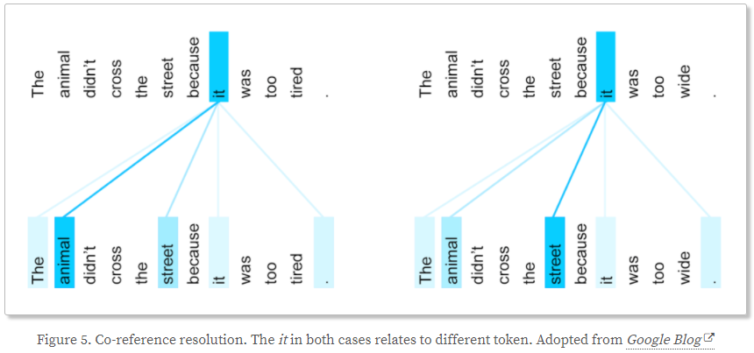
Coreference resolution
It is worth noting that this self-attention strategy allows to face the issue of coreference resolution where e.g. word “it” in a sentence can refer to different noun of the sentence depending on context.

Slide 26
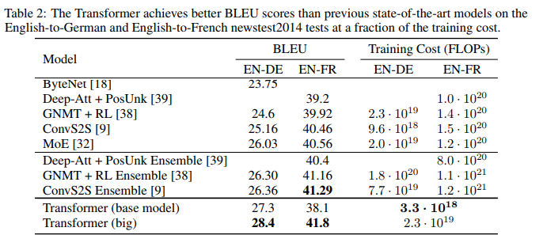

Slide 27
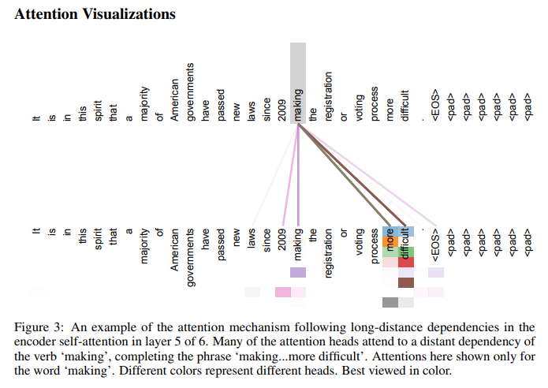

Slide 28
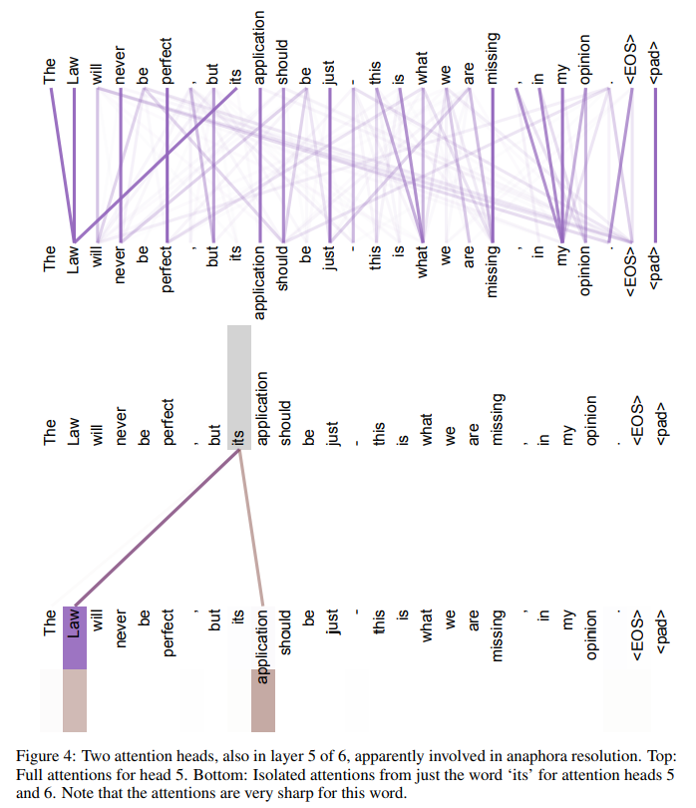

Slide 29
Spatial Transformer Networks -a different attention mechanism
Jaderberg et al, “Spatial Transformer Networks”, NIPS 2015

Slide 30
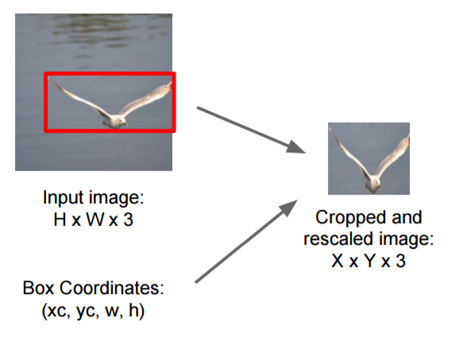
Would like to pay attention to certain areas of an image

Slide 31
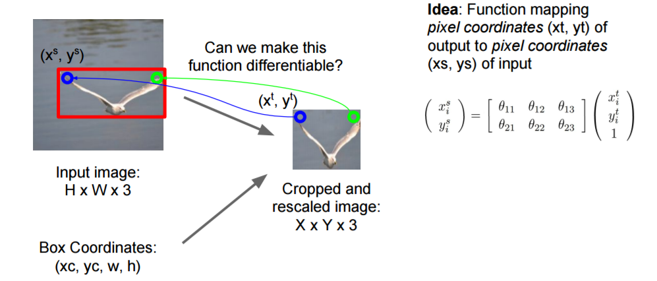

Slide 32
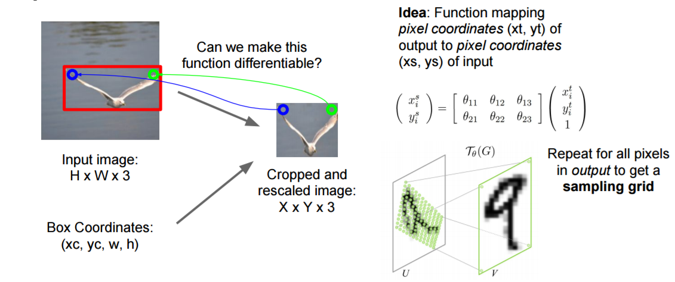
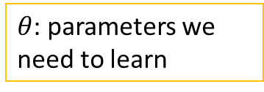
$θ$: parameters we need to learn
Affine transformation.
But it can be a more general transform

Slide 33
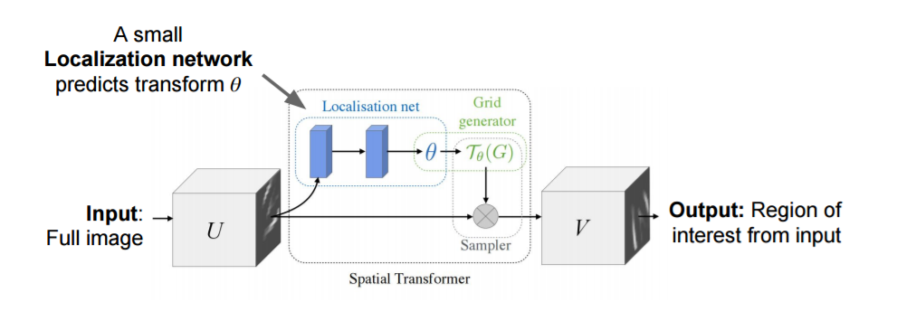
A module can be inserted to any place of a network
Used several times in later deepmind papers
The set of sampling points

Slide 34
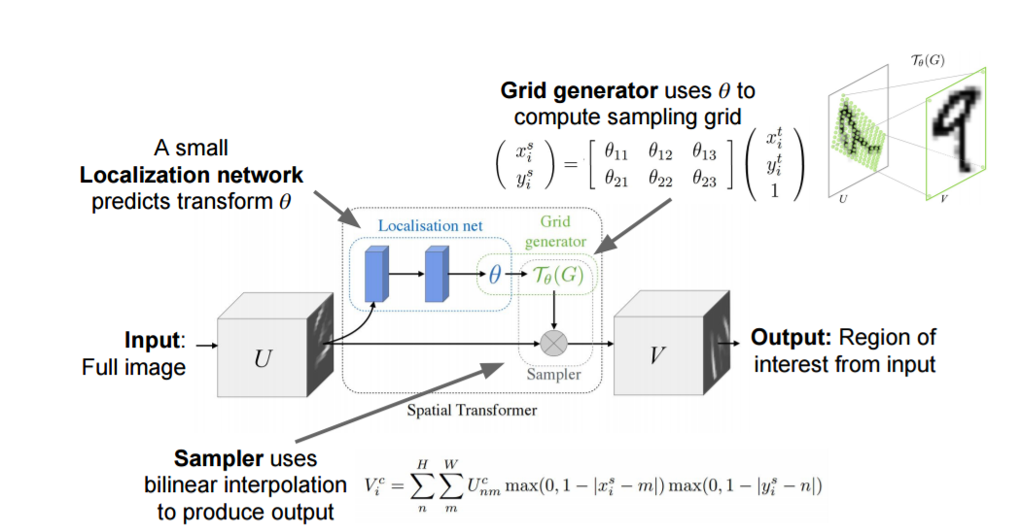
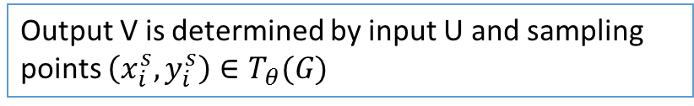
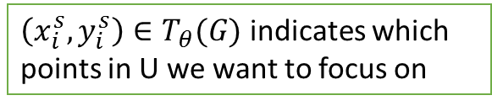

$\left(x_{i}^{s},y_{i}^{s}\right)∈T_{θ}(G)$ indicates which points in U we want to focus on
The localization network can be FC network or a CNN.
The last layer should a regression layer to produce $θ$
Output V is determined by input U and sampling points $\left(x_{i}^{s},y_{i}^{s}\right)∈T_{θ}(G)$

Slide 35
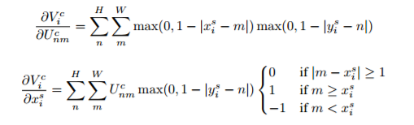

Slide 36
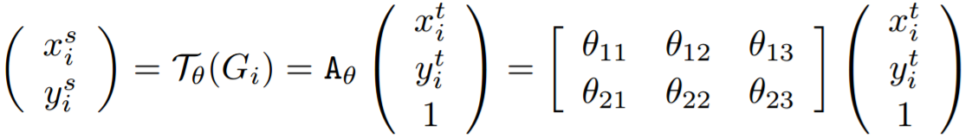
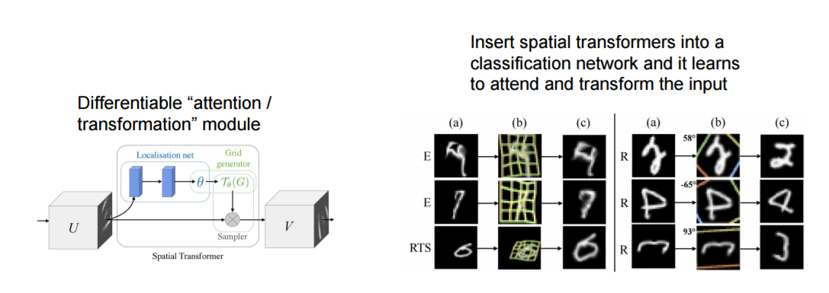
We can even learn the target grid B (using “thin plate spline”) (again through backprop)

Slide 37
Resources
Resources for attentions and NTMs
https://distill.pub/2016/augmented-rnns/
A good read : http://ruder.io/deep-learning-nlp-best-practices/
(lot of notes and tricks for deep learning in NLP)
Google cache: http://webcache.googleusercontent.com/search?q=cache:t_VgmDEvBo8J:ruder.io/deep-learning-nlp-best-practices/+&cd=3&hl=en&ct=clnk&gl=us
https://distill.pub/2016/augmented-rnns/#attentional-interfaces
(with very nice animation)
https://distill.pub/ (strongly recommend!)

Slide 38
Thanks
Some materials are taken from https://blog.heuritech.com/2016/01/20/attention-mechanism/
https://mchromiak.github.io/articles/2017/Sep/12/Transformer-Attention-is-all-you-need/#.WtstO3puaUl

